Slide 1
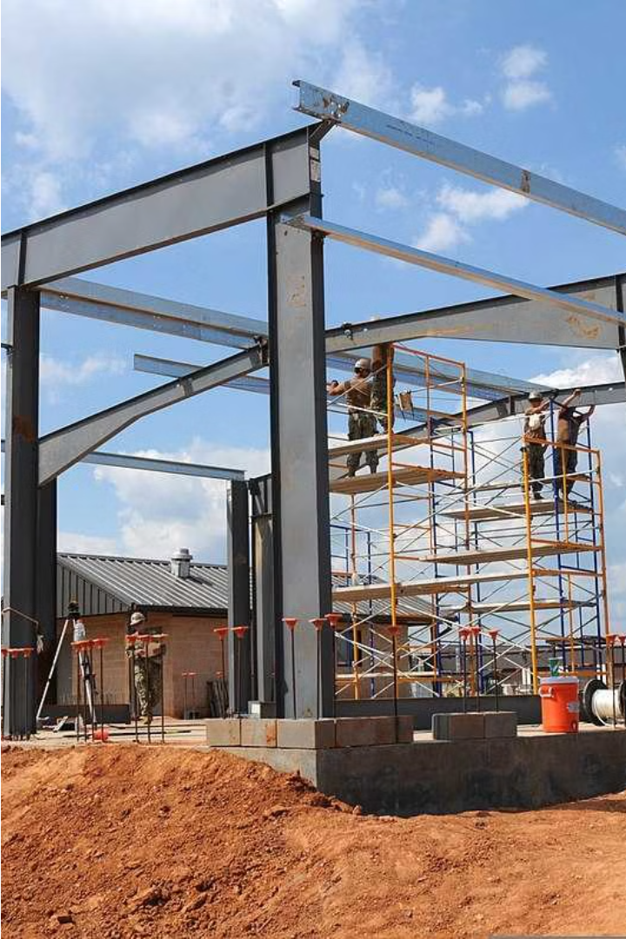
Metal and Machine
Metal and Machine is a leading manufacturer of pre-engineered steel buildings in the UAE. Based in Umm Al Quwain and Dubai, the company has mastered the PEB concept through continuous innovation and experience, delivering exceptional quality and satisfaction to its diverse clientele.

Slide 2
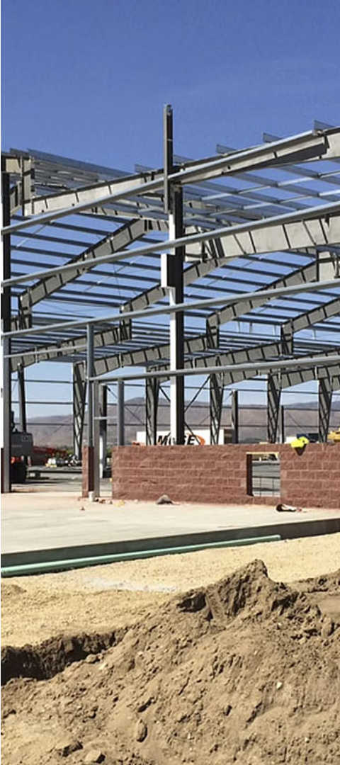
Our Expertise in PEB Structures
Advanced Engineering Design
Seamless Project Management
Our team of experienced engineers utilizes cutting-edge design software to create innovative, structurally sound PEB solutions tailored to each client's unique needs.
We oversee every aspect of PEB projects, from planning and fabrication to timely on-site installation, ensuring a smooth and efficient process for our clients.
Quality Craftsmanship
Our state-of-the-art manufacturing facility allows us to meticulously fabricate each PEB component to the highest standards, guaranteeing precision and durability.

Slide 3
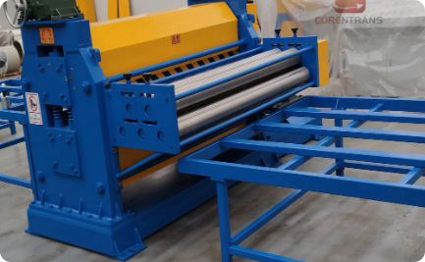
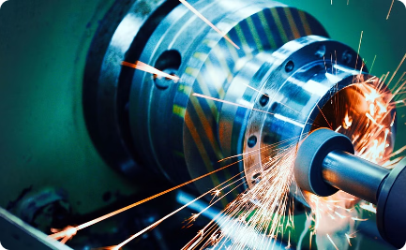
Serving Customers Across the UAE
Nationwide Presence
Diverse Projects
Satisfied Clients
With strategically located offices and manufacturing facilities across the UAE, we are able to efficiently serve customers throughout the region.
Our team has successfully completed a wide range of pre-engineered steel building projects for clients in various industries across the UAE.
By consistently delivering high-quality products and exceptional service, we have earned the trust and repeat business of customers throughout the UAE.

Slide 4
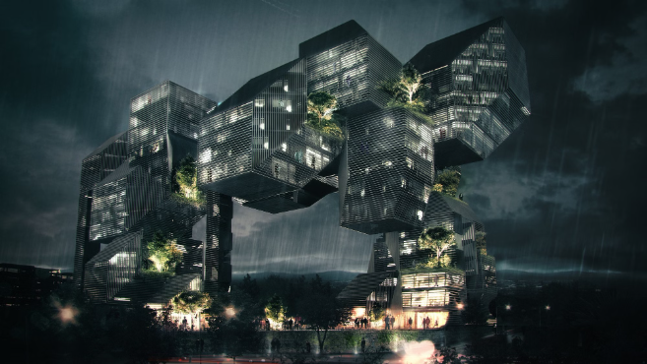
Innovative Design Approach
At Metal and Machine, we pride ourselves on our innovative design approach. Our team of skilled engineers and architects meticulously plan each project, leveraging the latest technologies and software to create custom, high-performance PEB structures tailored to our clients' unique needs.
From conceptualization to final delivery, we prioritize efficiency, sustainability, and structural integrity, ensuring our buildings not only look stunning but also withstand the rigors of the UAE's climate and demands.

Slide 5
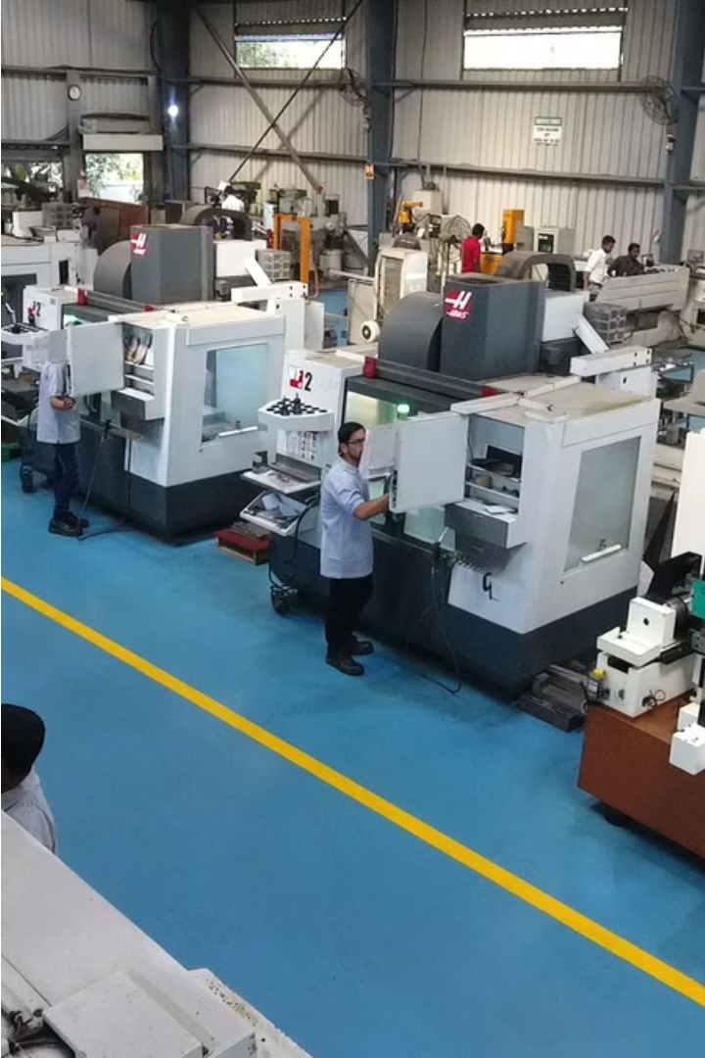
State-of-the-Art Manufacturing Facility
At Metal and Machine, we operate a cutting-edge manufacturing facility that utilizes the latest technologies and equipment to ensure the highest quality pre-engineered steel buildings. Our advanced production line allows us to efficiently fabricate and assemble complex steel structures with unparalleled precision.
From state-of-the-art computer-controlled cutting and welding machines to a climate-controlled workspace, every aspect of our facility is designed to optimize productivity, quality, and safety. This commitment to excellence enables us to deliver superior pre-engineered steel solutions to our customers across the UAE.

Slide 6
Efficient Design Team
Extensive Experience
Innovative Thinking
Attention to Detail
Collaborative Approach
Every aspect of the design process is meticulously planned and executed by our experts. From the initial concept to the final blueprints, they ensure that every detail is accounted for to deliver exceptional results.
Our design team comprises seasoned professionals with decades of experience in the pre-engineered steel building industry. They have honed their skills through countless successful projects across the UAE.
The team is constantly exploring new design techniques and technologies to push the boundaries of what's possible in PEB construction. They are adept at crafting custom solutions to meet the unique requirements of each client.
The design team works closely with clients to understand their vision and requirements. They engage in open communication throughout the process, incorporating client feedback to refine the design and achieve optimal outcomes.

Slide 7
Satisfied Clients Across the State
At Metal and Machine, we have earned the trust and satisfaction of clients across the UAE. Our commitment to quality and innovation has resulted in successful projects that meet and exceed our customers' expectations.
From government entities to private enterprises, we have a proven track record of delivering pre-engineered steel buildings that are both functional and aesthetically pleasing.

Slide 8
Understanding Customer Needs
Tailored Solutions
Collaborative Approach
Exceptional Service
At Metal and Machine, we deeply understand the unique requirements of each customer, and we craft tailored pre-engineered steel building solutions to meet their specific needs.
Our commitment to customer satisfaction is unparalleled. We go the extra mile to deliver outstanding service, from initial consultation to final project completion.
We work closely with our clients, actively listening to their concerns and ideas, to ensure our designs and constructions align perfectly with their vision.

Slide 9
Quality Pre-Engineered Steel Buildings
Quality Engineering
Customizable Design
Efficient Construction
Metal and Machine specializes in designing and manufacturing high-quality pre-engineered steel buildings that meet the strictest industry standards.
Our flexible design process allows for complete customization to meet the unique needs and requirements of each client's project.
The pre-engineered steel construction process is fast, efficient, and minimizes on-site labor, reducing overall project timelines and costs.

Slide 10
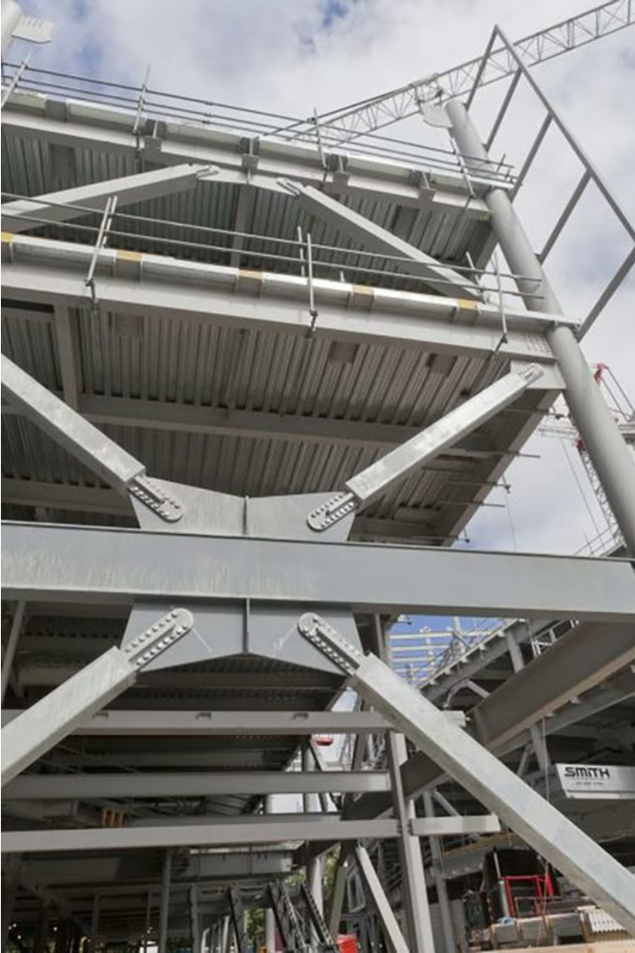
Know More
E-mail Phone
metalandmachine@gmail.com +971501922352, saurabh@metalnmachine.com +971504328270
Location
Plot no 8 , Block 6, Sector 711, New Industrial Area Umm Al Quwain, UAE
Website
Fencing Suppliers & Manufacturers in Dubai | UAE

