Slide 1
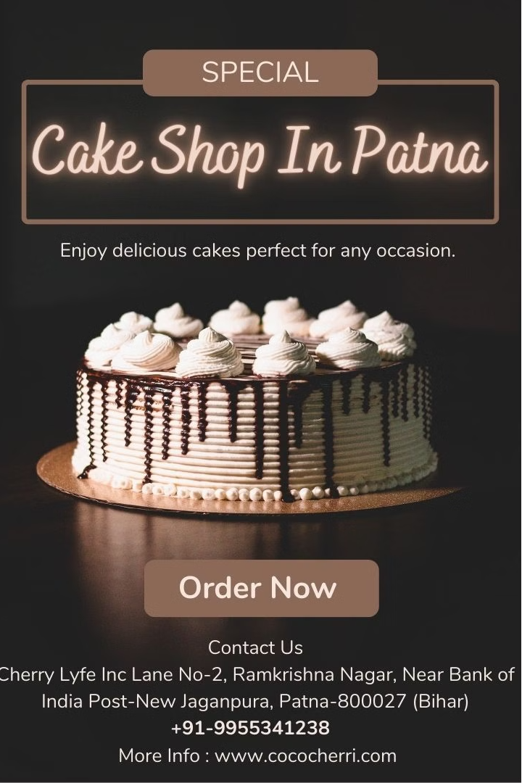



Cococherri: The Best Cake Shop in Patna
Cococherri is the premier cake shop in Patna, offering an exquisite selection of delectable cakes for every celebration. From mouthwatering birthday cakes to elegant housewarming treats, we deliver joy and delight to your doorstep across neighboring cities.
by Cococheri

Slide 2
Celebration Cakes for Every Occasion
Birthdays
Housewarmings
Anniversaries
Our 100% egg-free birthday cakes are baked to perfection, ensuring a delightful experience for all.
Commemorate new beginnings with our stunning housewarming ceremony cakes, crafted to impress.
Celebrate milestones with our exquisite anniversary cakes, tailored to make your special day even sweeter.

Slide 3
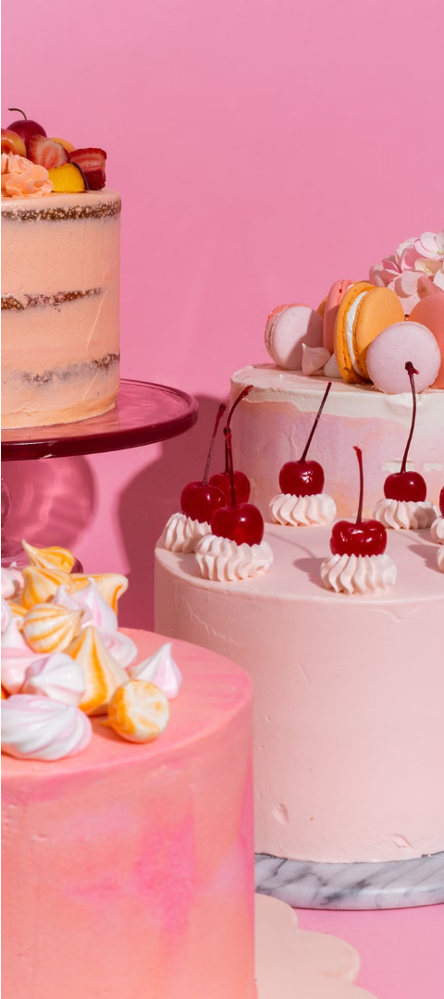
Exquisite Selection of Delicious Cakes
1
Moist and Flavorful
2
Visually Stunning
Our cakes are baked to perfection, with a moist, tender crumb and rich, indulgent flavors.
Each cake is meticulously decorated to be a true work of art, sure to impress your guests.
3
Made with Love
Our team of skilled bakers pour their passion into every creation, ensuring a truly exceptional experience.

Slide 4
Home Delivery Across Neighboring Cities
Delivery in Minutes
No Extra Charges
With our efficient delivery service, your cake will arrive at your doorstep in no time.
We offer free delivery within Patna and the surrounding areas, with no hidden fees.
Reliable Service
Convenient Ordering
Our dedicated team ensures your order is handled with the utmost care, every time.
Place your order online or over the phone for a seamless and hassle-free experience.

Slide 5



100% Egg-Free Birthday Cakes
Egg-Free
Delicious Flavor
Celebration Ready
Our birthday cakes are made without eggs, making them suitable for all dietary preferences.
Despite being egg-free, our cakes are still moist, rich, and bursting with flavor.
Perfect for birthdays, our egg-free cakes will make your special day even more memorable.

Slide 6
Cococherri: Bringing Joy to Every Celebration
Cake Types
Birthday, Housewarming, Anniversary, and more
Delivery Area
Patna and surrounding cities
Delivery Time
As Promised time after order placement
Delivery Charge
Free of cost

Slide 7
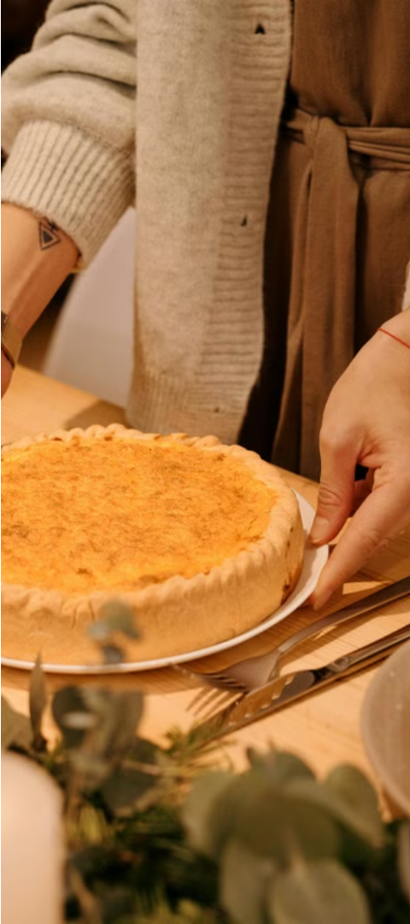

Our Commitment to Quality
1
Finest Ingredients
We use only the highest quality, carefully sourced ingredients to ensure exceptional taste and texture.
2
Meticulous Preparation
Our skilled bakers follow precise recipes and techniques to bring out the best in every cake.
3
Uncompromising Standards
Each cake is inspected for perfection before being carefully packaged for delivery.

Slide 8
Elevate Your Celebrations with Cococherri
Exceptional Taste
Stunning Presentation
Convenient Delivery
Indulge in the rich, moist flavors of our cakes, made with the finest ingredients.
Our cakes are meticulously decorated to be the centerpiece of any celebration.
Enjoy the convenience of our quick, free delivery service across Patna and nearby cities.

Slide 9
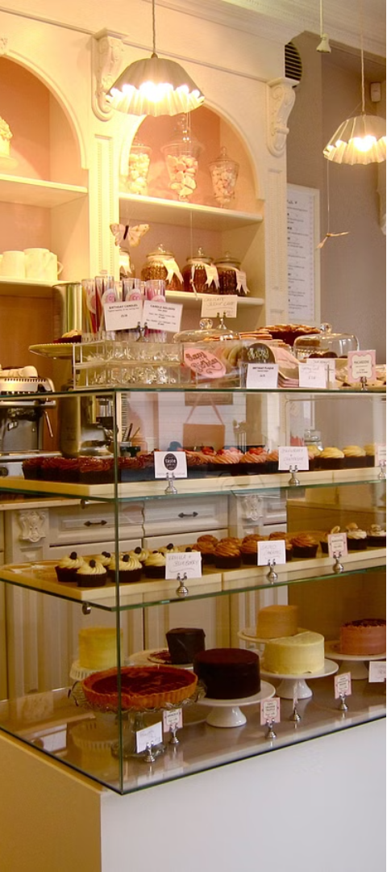




Contact Us
Call Us
Reach out to our friendly team at +91-9955341238 to place your order or inquire about our services.
Visit Our Shop
Stop by our bakery at Cherry Lyfe Inc Lane No-2,Ramkrishna Nagar ,Near Bank of India Post-New Jaganpura, Patna-800027 (Bihar), to see our stunning cake displays in person.
Order Online
Conveniently place your order through our website at www.cococherri.com.

