Slide 1
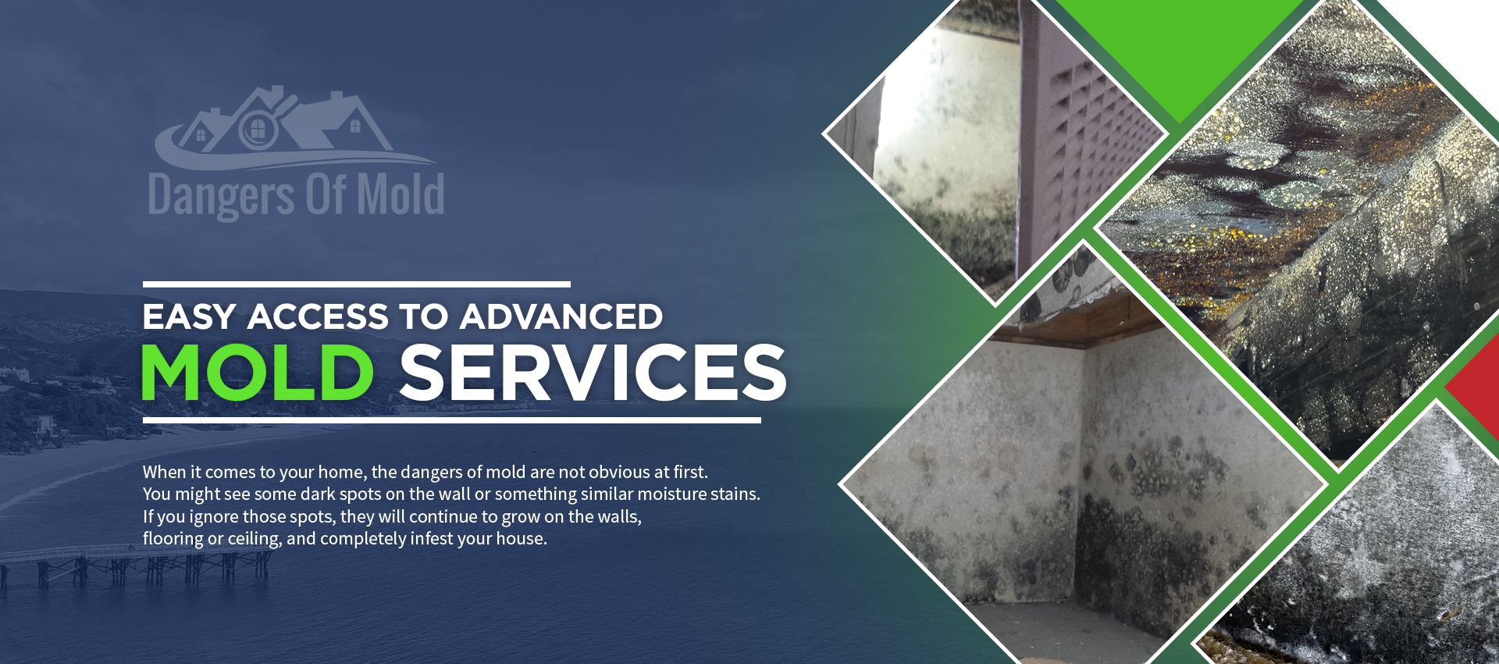
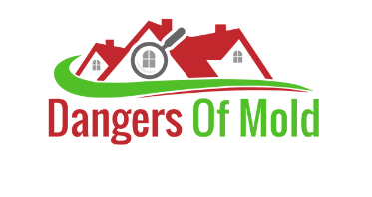


Slide 2
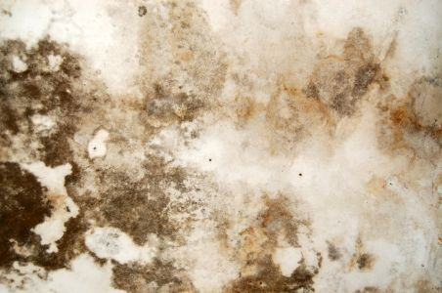
Mold Allergy & Asthma Basics
Mold spores also float in the air, and they are invisible to the naked eye. In a mold-infested house, many types of harmful mold spores float around. Spores that you, without a doubt, inhale. Spores that can enter your lungs and make you short of breath, most commonly known as asthma.
The beginning of the simple mold allergy is, again, not that alarming and is. Because of this, people tend to ignore itchy eyes or a runny nose, blaming it on the common cold sometimes. Ignorance can come at a great price since complications from mold allergies are also common.

Slide 3
Most Comprehensive Mold Facts & Information
Health
Mold spores also float in the air, and in a mold-infested house, many types of harmful mold spores float around.
Education
Moreover, mold spores are also the cause of fungal infections. Your digestive tract or the skin, together with the lungs
Lab Reports
The Laboratory team can take care of the black mold samples from your house, no matter how bad it is.
Treatment
We can locate professionals and the newest treatments at the highest standards eliminating the dangers of mold

Slide 4
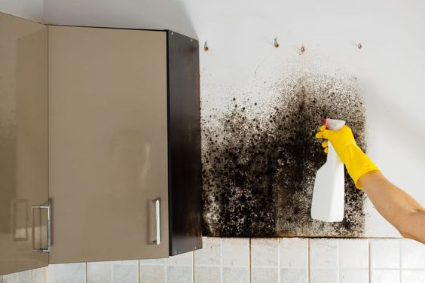
Easy Access to
Advanced Mold Services
When it comes to your home, the dangers of mold are not obvious at first. You might see some dark spots on the wall or something similar moisture stains. If you ignore those spots, they will continue to grow on the walls, flooring or ceiling, and completely infest your house.

Slide 5
Our Fields of Specialization
Inspection & Testing
Residential & Commercial
Mold Removal & Cleaning
Mold Testing
Lab Analysis
Asbestos & Lead Testing
Certified Lab Data & Techs
Rapid Lab Turn Around Times
AIHA Lab Technicians

Slide 6
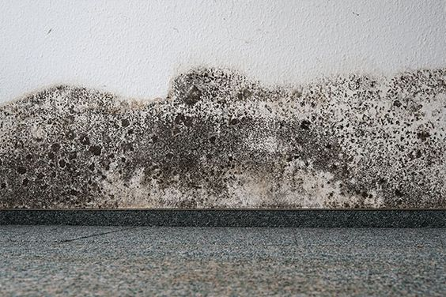
What Our Clients Have to Say
“Awesome service from a real professional mold specialist service. I look forward to working with them again.
Alice Tinkerton”
“Great information about mold and mold testing. I will share this information with my family!
Cameron Alistair”

Slide 7
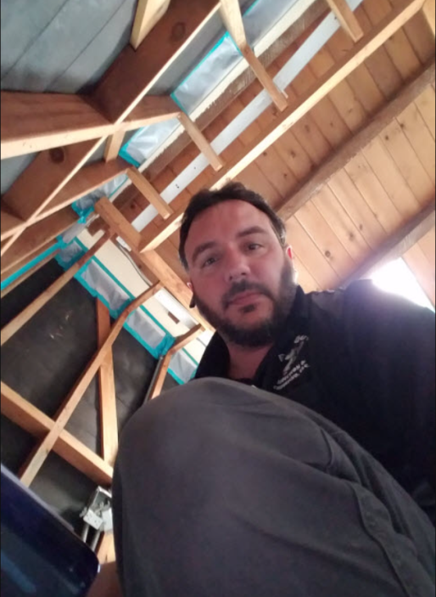
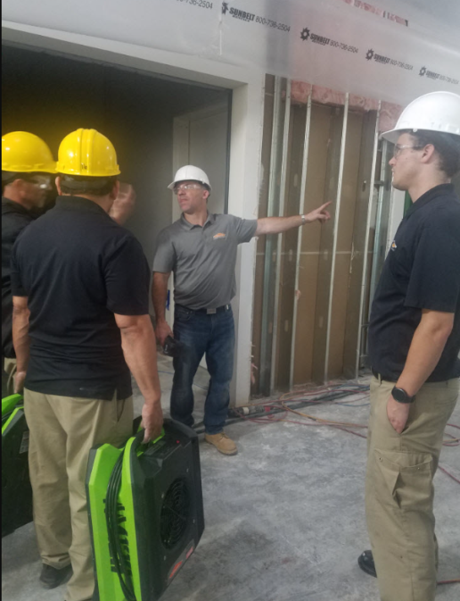
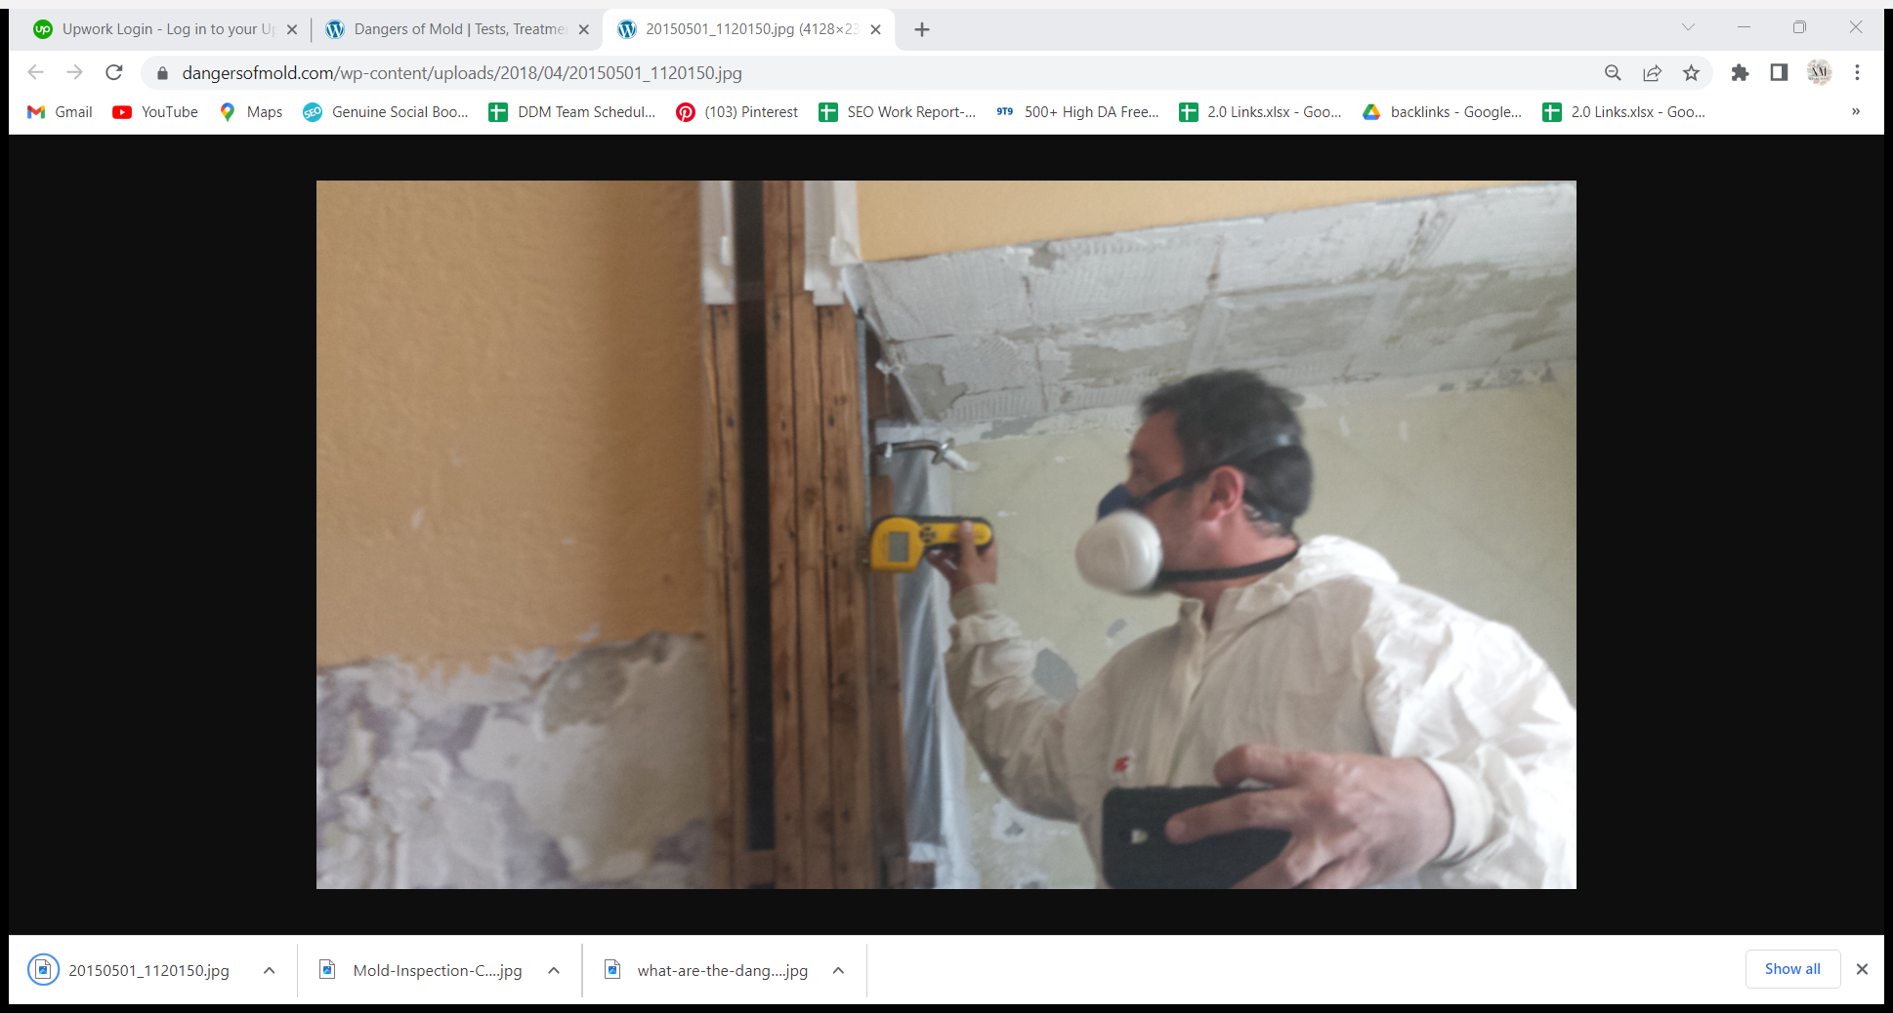
Our Mold Inspection Team
You can be good in many specialties but it’s hard to be exceptional at all. Each of our team members is trained in a special branch of building sciences and laboratory services.
Miles B.
Inspection & Testing
Brandon H
Commercial Property
Robert S.
Mold Removal & Cleaning

Slide 8
Make Your Appointment Today
Ignoring mold that forms in and around the house premises can have hard repercussions. Experts say there is over 300,000 types of mold, most of which are dangerous for your health when found growind indoors.
You can find mold anywhere there is humidity, light, and warmth. This makes a house with poor ventilation, leaks, and wet spots a death trap for its inhabitants.

Slide 9
Contact US
Address: 9800 Topanga Cyn, Los Angeles
Phone: 818-745-6653
Website: www.dangersofmold.com

Slide 10
Thank You

