Slide 1
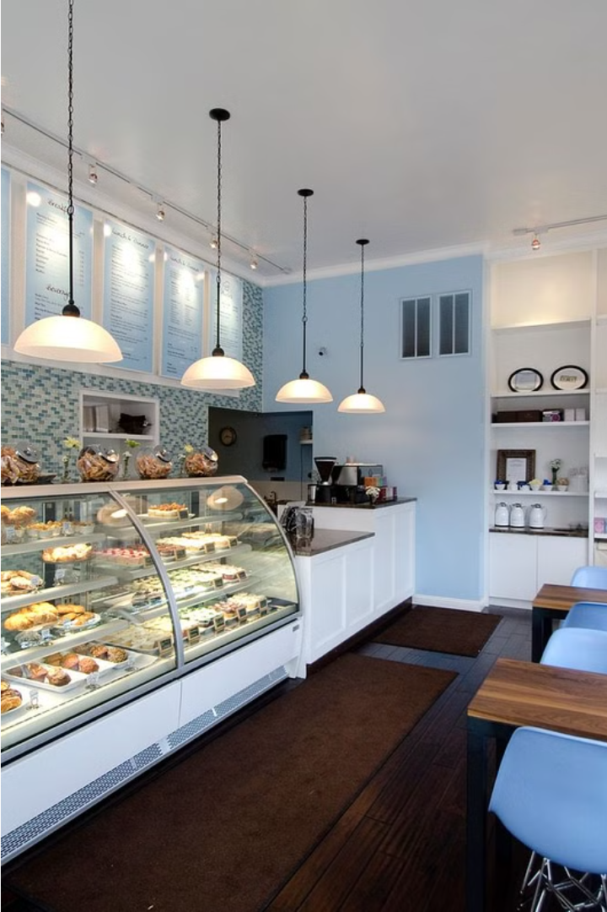


Cococherri: Patna's Premier Online Cake Shop
Cococherri has been go-to destination for Online Cake Delivery In Patna, offering freshly baked, 100% egg-free cakes for every occasion. From birthdays to anniversaries, our master pastry chefs craft delightful, customizable treats that bring joy and sweetness to your doorstep.
by Cococheri

Slide 2
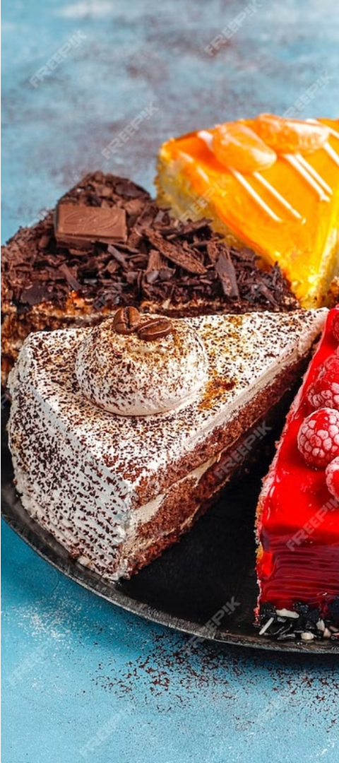
Freshly Baked Cakes for Every Occasion
1
Birthdays
2
Weddings
Celebrate with a personalized cake that captures the essence of the occasion.
Our elegant, tiered cakes are the perfect centerpiece for your special day.
3
Anniversaries
Mark the milestones in your life with a delicious, heartfelt cake.

Slide 3
100% Egg-Free, Handcrafted Delights
Egg-Free Recipes
Handcrafted Artistry
Uncompromising Quality
Our cakes are made with high-quality, plant-based ingredients, ensuring they are 100% egg-free.
Each cake is lovingly crafted by our skilled pastry chefs, who pour their passion into every creation.
We never sacrifice taste or texture, delivering delectable cakes that exceed your expectations.

Slide 4
Endless Customization Options
Flavors
Decorations
Choose from a variety of classic and innovative flavors to suit every palate.
Personalize your cake with custom designs, toppers, and handwritten messages.
Sizes
Dietary Needs
From intimate single-serve cakes to grand, multi-tiered masterpieces, we have you covered.
Accommodate special dietary requirements with our range of sugar-free, gluten-free, and vegan options.

Slide 5



Hassle-Free Online Ordering Experience
Quick Delivery
Dedicated Support
Secure Payments
Timely delivery to ensure your cakes arrive fresh and ready to enjoy.
Safe and convenient online payment options to give you peace of mind.
Our friendly customer service team is here to assist you every step of the way.

Slide 6
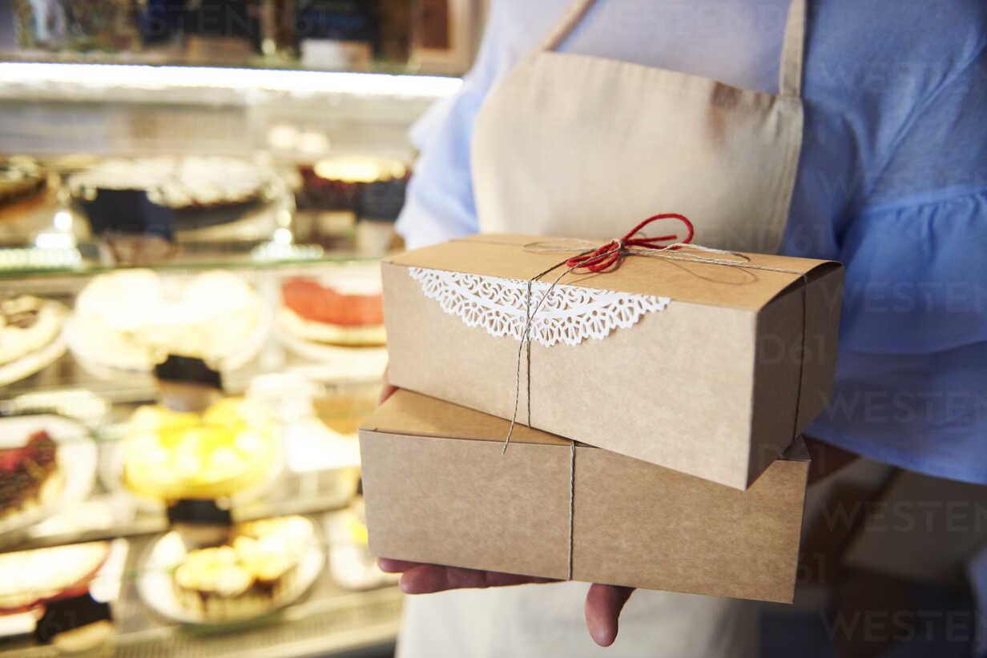



Delivering Joy and Sweetness to Your Doorstep
Order Online
Browse our selection and customize your cake with just a few clicks.
Bake with Love
Our talented team of bakers handcraft each cake with care and precision.
Deliver to You
Sit back and relax as we bring your delicious creation straight to your door.

Slide 7
Contact Us
Phone
+91-9955341238
Email
cs@chococherri.com
Address
Cherry Lyfe Inc Lane No-2,Ramkrishna Nagar ,Near Bank of India Post-New Jaganpura, Patna-800027 (Bihar)
Website
​www.cococherri.com

