Slide 1
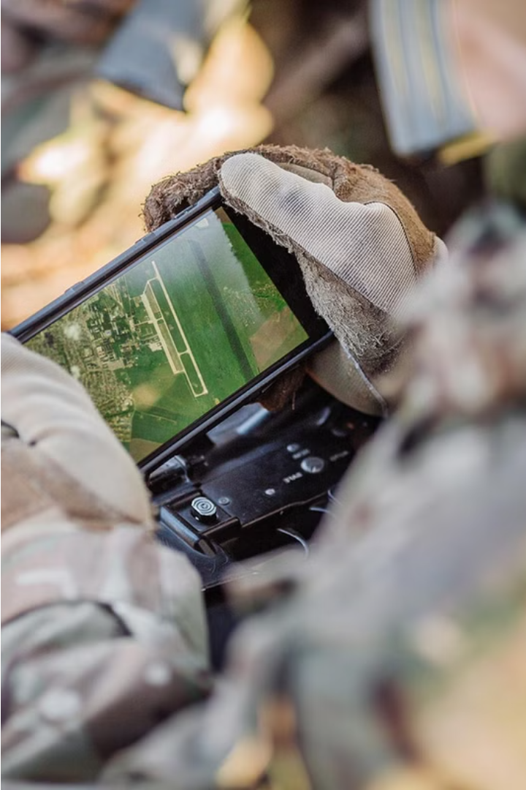


Introduction to B2K Holdings
B2K Holdings is a leading UK-based manufacturer and supplier of cutting-edge defense technologies. With decades of expertise, they provide innovative products and solutions to top-tier Defense contractors worldwide.
by B2K Holdings

Slide 2

Specialized Products for Defense Contractors
Cutting-Edge Technology
Mission-Critical Reliability
Unparalleled Customization
Comprehensive Support
B2K Holdings specializes in developing advanced, state-of-the-art products tailored to the unique needs of defense contractors. Our team of engineers and researchers are constantly innovating to push the boundaries of what's possible.
Reliability is paramount in the defense industry. Our products are engineered to withstand the harshest conditions and provide unwavering performance, ensuring mission success for our customers.
We understand that each defense contractor has distinct requirements. That's why we offer highly customizable solutions, allowing our clients to specify the exact features and capabilities they need.
Beyond product development, we provide comprehensive support services to our defense contractor clients. This includes training, maintenance, and rapid response to ensure seamless integration and optimal performance.

Slide 3
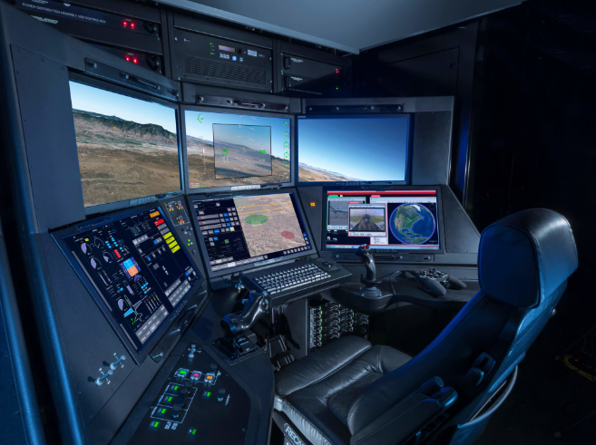
Ground Systems Development
B2K Holdings has a strong track record in the research and development of advanced ground system for defense applications. Our team of experts specializes in designing and engineering robust, high-performance platforms that can withstand the harshest operational environments.
From command-and-control centers to mobile ground stations, we leverage the latest technologies to deliver solutions that enhance situational awareness, improve decision-making, and support mission-critical operations.

Slide 4
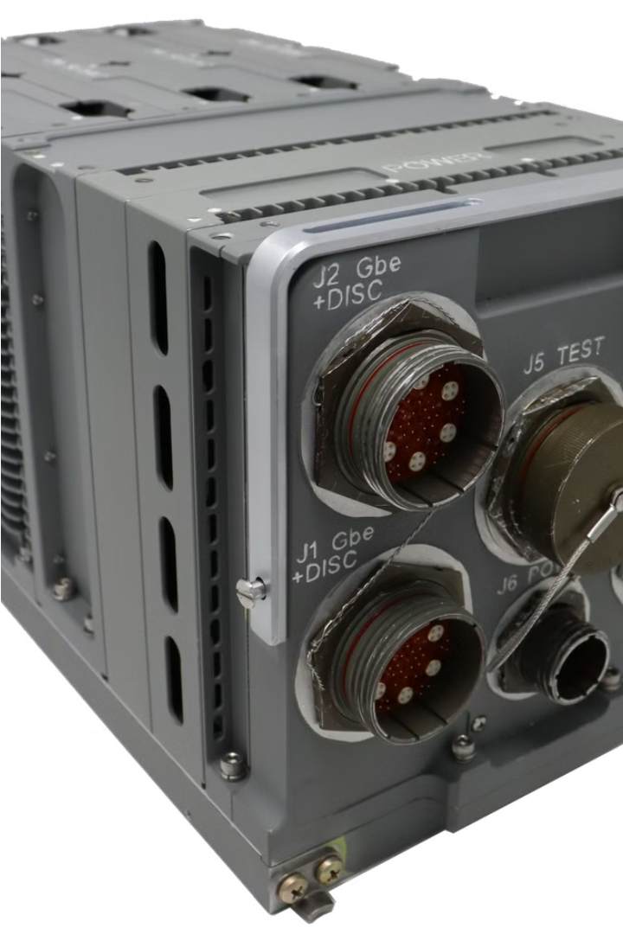
Airborne Mission Computers
B2K Holdings develops advanced airborne mission computers for defense contractors. These rugged, compact computers are designed to handle the demanding requirements of military aircraft, providing mission-critical processing power and situational awareness for pilots and crews.
Our airborne mission computers feature high-performance CPUs, solid-state storage, and specialized I/O for integrating with a wide range of avionics systems. Engineered to military standards, they deliver reliable operation in the harshest environments.

Slide 5

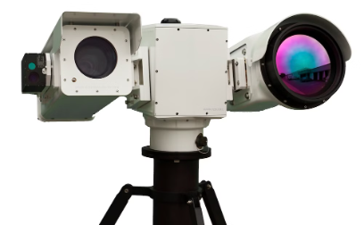
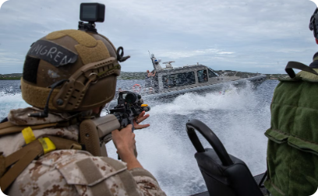
Long-Range Camera Solutions
Advanced Optics
Rugged Durability
Thermal Imaging
Our long-range cameras leverage cutting-edge optics and sensor technology to provide unparalleled image resolution and clarity, enabling precise target identification and tracking even at extreme distances.
Designed to withstand the rigors of the battlefield, our long-range cameras are built to military specifications, ensuring reliable performance in the harshest environments.
Our long-range cameras offer powerful thermal imaging capabilities, allowing for effective detection and tracking of targets in low-visibility conditions, such as darkness or smoke.

Slide 6
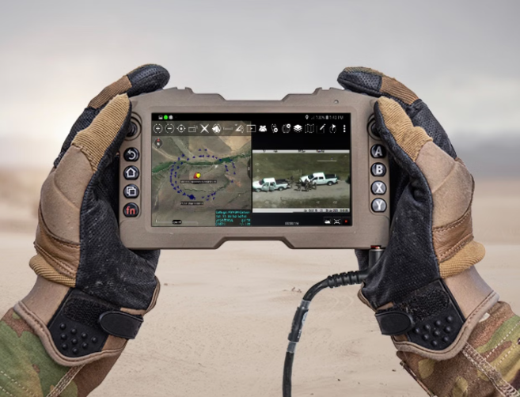
Military Rugged Display Expertise
B2K Holdings has developed a line of military-grade rugged displays that can withstand the harshest environments. These displays are shock and vibration resistant, operate in extreme temperatures, and feature high-brightness screens for excellent visibility in direct sunlight.
Our rugged displays are widely used in combat vehicles, aircraft, and naval applications, providing mission-critical information to operators in the field.

Slide 7
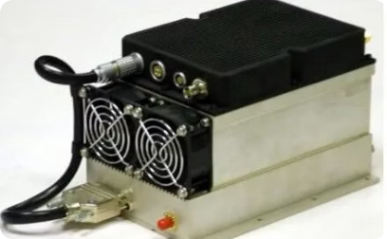
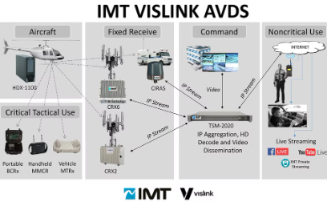
Video Downlinks
Advanced Design
Robust Transmission Capabilities
Intuitive Control Interfaces
Our high-performance video downlinks enable seamless real-time transmission of critical aerial imagery and data to ground control stations.
Engineered to withstand harsh operational environments, our video downlink systems deliver reliable, high-bandwidth data links for defense applications.
Our video downlink solutions feature user-friendly control interfaces, allowing operators to efficiently manage the transmission and capture of aerial video feeds.

Slide 8

Defense Contractors UK
Trusted Partnerships
Compliance Expertise
B2K Holdings has built strong relationships with leading defense contractors in the UK, providing specialized products and solutions to meet their unique requirements.
Our team understands the rigorous quality standards and security protocols required by the UK defense industry, ensuring seamless integration of our products.
Domestic Support
As a UK-based manufacturer, we offer localized technical support and rapid response times to our defense contractor customers across the country.

Slide 9
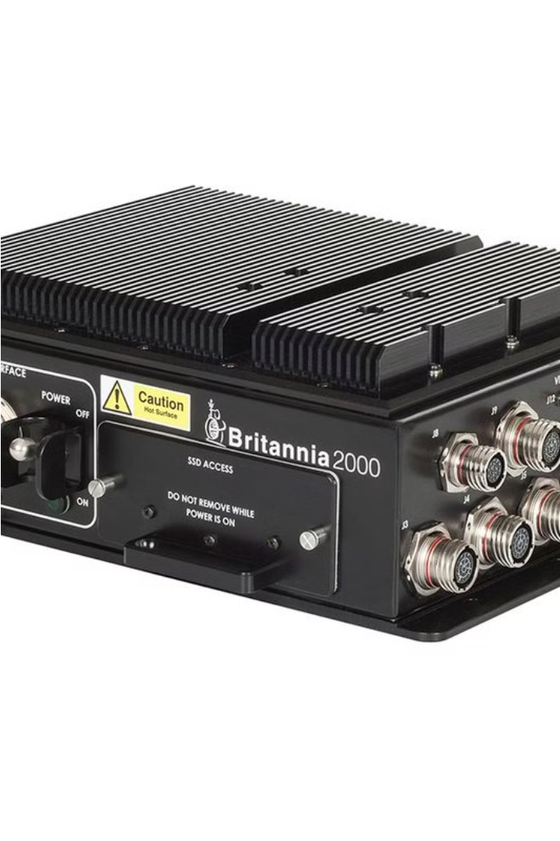
CAMC (Compact Airborne Mission Computer)
The CAMC is a highly advanced airborne mission computer developed by B2K Holdings for defense applications. Designed to withstand the rigors of military environments, this compact and rugged system provides powerful processing capabilities, seamless integration, and reliable performance in the most demanding scenarios.

Slide 10

Visit us to know more
Britannia 2000 Holdings
Mobile: +44 7717 292751
Telephone: +44 1344 885058
Email: sales@b2kholdings.co.uk
Address: 4, Millside Park, Winkfield, Windsor SL4 4PX, United Kingdom

