Slide 1

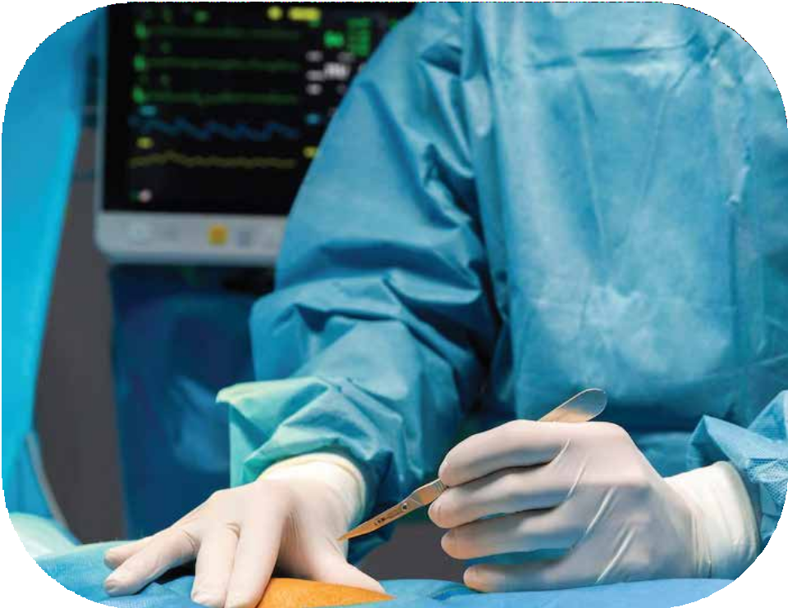

Slide 2

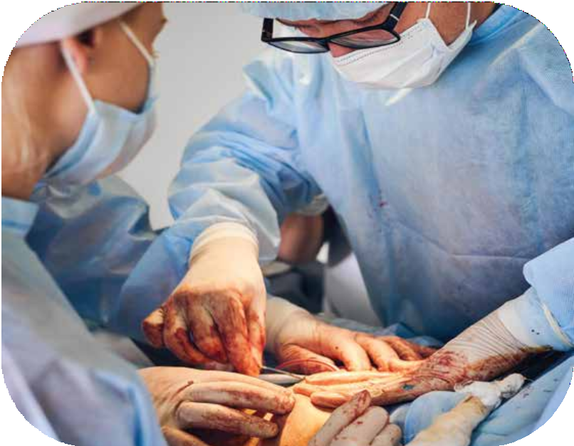
THE ROLE OF HAND SURGERY IN SURGICAL RECOVERY
When facing the prospect of hand surgery, whether for an injury, medical condition, or post-traumatic reconstruction, patients often focus on the surgical procedure itself as the key to improvement. However, what many may not realize is that the post-surgical phase, particularly hand therapy, plays an equally crucial role in the recovery journey. Hand therapy is a specialized branch of rehabilitation that is essential for helping patients regain strength, dexterity, and functionality in their hands after surgery. In this comprehensive guide, we will dive deep into the signiﬁcance of hand therapy and how it contributes to successful post-surgical recovery.

Slide 3
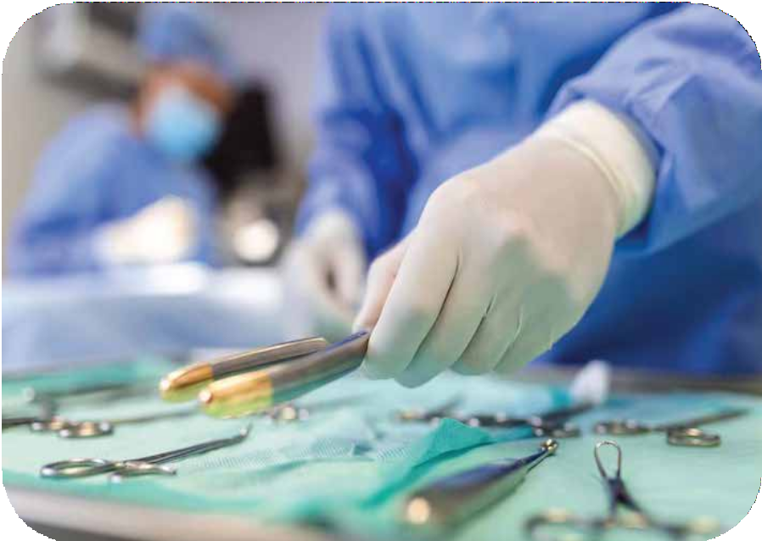
Understanding Hand Surgery and Its Impact
Before delving into the role of hand therapy, let’s ﬁrst grasp the signiﬁcance of hand surgery. Hand surgery encompasses a wide range of procedures, from treating common conditions like carpal tunnel syndrome and trigger ﬁnger to more complex surgeries like tendon repairs and joint replacements. The goal of these surgeries is to alleviate pain, restore function, and improve the overall quality of life for patients with hand-related issues.
Injuries: Traumatic accidents, sports-related injuries, or workplace accidents can result in fractures, dislocations, or soft tissue damage to the hand.
Degenerative Conditions: Conditions like arthritis can cause chronic pain and limited mobility, necessitating surgical intervention.
Nerve Compression: Conditions such as carpal tunnel syndrome occur when nerves in the hand are compressed, leading to numbness, tingling, and weakness.
Tendon and Ligament Issues: Tears or damage to tendons and ligaments can affect hand function and require surgical repair.

Slide 4



FOLLOW US
https://www.facebook.com/Hand-Surgery-Professionals-111311928159239
https://www.linkedin.com/in/hand-surgery-professionals-62b195243/
https://twitter.com/handsurgerypro

Slide 5
CONTACT US
971 58 601 5462
info@ehssociety.org

