Slide 1

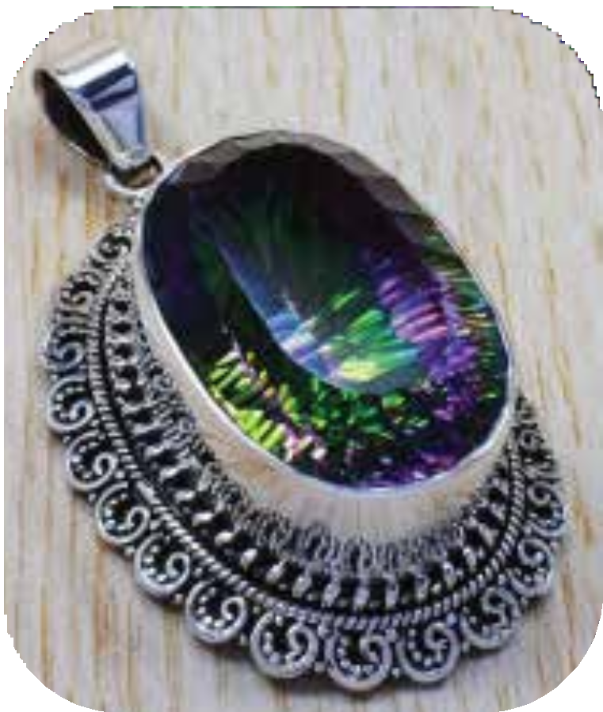
https://www.silverjewelrydoctor.com/blog/7-tips-for-buying-wholesale-sterling-silver-jewelry

Slide 2
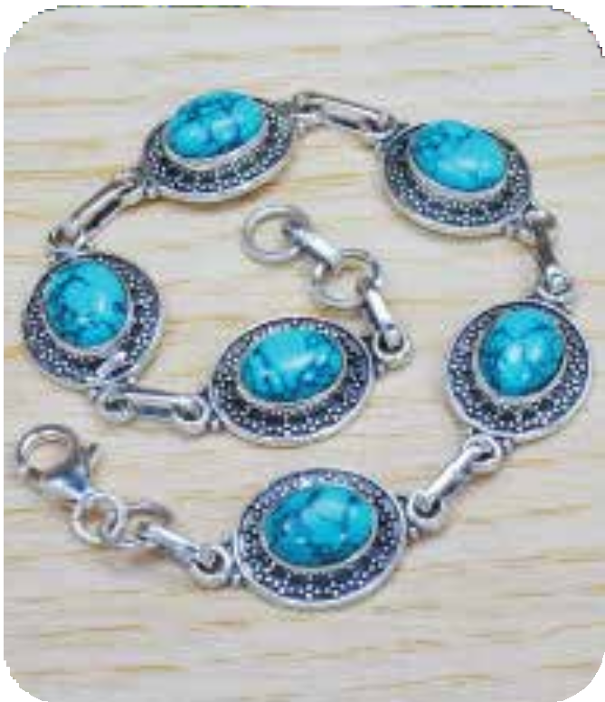
ABOUT US
Wholesale Silver Jewelry Doctor has carved a reputable niche for itself within the realm of silver jewelry and handicraft manufacturing, celebrated for its unwavering commitment to quality and exceptional services. As a purveyor of high standards, the company is dedicated to offering a splendid array of wholesale silver jewelry that possesses the innate ability to transform one's personality through the allure of silver and gemstone adornments. Esteemed as a distinguished manufacturer and exporter of Indian silver jewelry and handicrafts, Wholesale Silver Jewelry Doctor has not only made its mark within the domestic expanse of the USA but has also garnered global recognition for its excellence. Boasting an import-export license code with the identiﬁer 1315907178, the company exudes credibility and reliability, which has translated into unwavering trust from its patrons.
https://www.silverjewelrydoctor.com/blog/7-tips-for-buying-wholesale-sterling-silver-jewelry

Slide 3
Sterling silver jewelry is an ideal option for everyday use but there are a few things that you must follow when you purchase wholesale jewelry in sterling silver. First of all, you can begin your search online as this is the best way to ﬁnd the best deals from the wholesalers who are available online. There are a lot of wholesale dealers who focus exclusively on sterling silver jewelry.
Purchasing wholesale jewelry is a great idea as you can save huge sums of money especially if you are purchasing sterling silver jewelry. When you purchase it from a wholesaler, you will literally be paying half the cost when compared to what you would have paid if you had to purchase from a retailer. Here are some tips for buying wholesale silver jewelry.
Legitimate Products
Making sure that the supplier is legitimate is important however, you must always check if the products are legitimate as well. Jewelry is expensive and buying fake would be a waste of a lot of money. While every company will claim to be selling the authentic products, still it is important for you to learn about the composition of the product.
Determining Quality
Sterling silver should be stamped with .925 or 925, meaning its 925 Sterling Silver Jewellery. Anything with less silver content than that may not keep its original color. If no stamp is visible, be sure you trust the jeweler from whom you are buying; otherwise, look elsewhere. Before buying silver, you should take some time to see the imperfections. Check the strength of clasps and earring posts. Make sure chain link bracelets and necklaces have no kinks and will not kink easily.
https://www.silverjewelrydoctor.com/blog/7-tips-for-buying-wholesale-sterling-silver-jewelry

Slide 4




FOLLOW US
https://www.facebook.com/silverjewelrydoctor
https://twitter.com/silverjdoctor https://www.instagram.com/silverjewelrydoctor/
https://in.pinterest.com/SilverJDoctor/
https:/ api.whatsapp.com/send?phone=66838021472 https://line.me/R/ti/p/%40806vlafh
https://www.silverjewelrydoctor.com/blog/7-tips-for-buying-wholesale-sterling-silver-jewelry

Slide 5
CONTACT US
2 kb, raj apartment, keshav path, ahinsa circle,
c-scheme, jaipur, rajasthan, india
+66-838021472
Mysilvershop@gmail.com
https://www.silverjewelrydoctor.com/blog/7-tips-for-buying-wholesale-sterling-silver-jewelry

Slide 6
https://www.silverjewelrydoctor.com/blog/7-tips-for-buying-wholesale-sterling-silver-jewelry

