Slide 1



Piccola Cucina Casa: The New Venture
Piccola Cucina Casa, the latest addition to the Piccola Cucina group, opened its doors on April 25, 2024, seeking where to eat in Brooklyn , inviting diners on a culinary journey through the diverse regions of Italy. Located in the heart of Brooklyn, this new venture promises an authentic Italian experience that celebrates the country's rich gastronomic heritage.
by piccola cucina

Slide 2

Location and Concept
Location
Concept
Piccola Cucina Casa is situated at 141 Nevins Street in the vibrant neighborhood of Brooklyn, providing a convenient and accessible dining destination for both locals and visitors alike.
The restaurant's concept is rooted in showcasing the culinary diversity of Italy, offering guests a unique opportunity to savor the flavors of different regions in a warm and inviting setting.

Slide 3
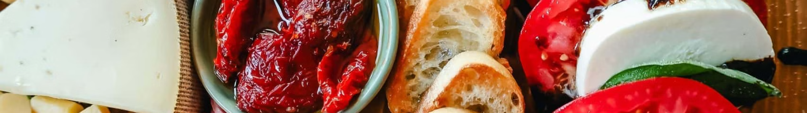

Seasonal Italian Menu
1
Diverse Offerings
2
Seasonal Approach
3
Regional Specialties
The menu at Piccola Cucina Casa is designed to showcase the gastronomic diversity of Italy, featuring a range of dishes from across the country.
The menu is crafted using the freshest seasonal ingredients, ensuring that the flavors and offerings change throughout the year to reflect the best of what the seasons have to offer.
From the grilled octopus of Puglia to the schnitzel Milanese of Lombardy, the menu pays homage to the iconic dishes that have made Italian cuisine renowned worldwide.

Slide 4

Sicilian Wine Selection
Extensive Collection
Sicilian Terroir
Pairing Expertise
Piccola Cucina Casa boasts a carefully curated wine list that features over 150 selections from the renowned wine-producing regions of Sicily.
The wine list showcases the unique terroir and grape varietals that have made Sicilian wines a beloved cornerstone of Italian oenology.
The restaurant's knowledgeable staff is on hand to guide guests in selecting the perfect wine pairings to complement the flavors of their meals.

Slide 5



Seasonal Cocktails
Citrus Infusions
Herbal Notes
Craft Mixology
Seasonal cocktails feature fresh citrus ingredients, adding a refreshing twist to traditional Italian libations.
Aromatic herbs, such as basil and rosemary, are incorporated into the cocktail menu, enhancing the Mediterranean flavors.
The skilled bartenders at Piccola Cucina Casa combine premium spirits, house-made syrups, and innovative techniques to craft exceptional seasonal cocktails.

Slide 6
Atmosphere and Design
Warm and Inviting
Attention to Details
Communal Dining
The restaurant's design evokes the cozy and convivial atmosphere of a traditional Italian trattoria, with rustic accents and a welcoming ambiance.
From the carefully curated artwork to the carefully selected furnishings, every element of the restaurant's design has been meticulously considered to create an immersive Italian experience.
The layout and seating arrangements at Piccola Cucina Casa encourage a sense of community and shared enjoyment, fostering a lively and social dining experience.

Slide 7
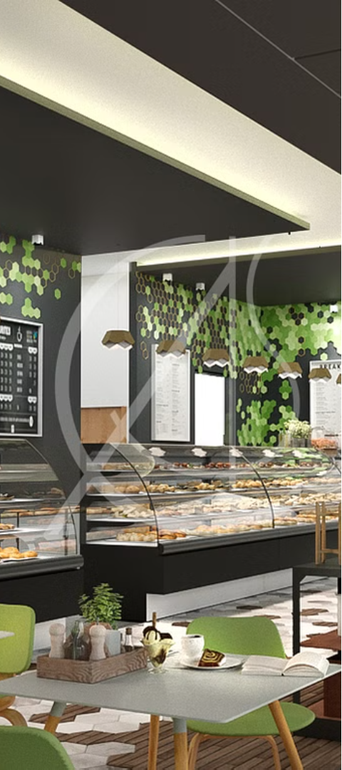




Commitment to Sustainability
Local Sourcing
Piccola Cucina Casa prioritizes working with local producers and suppliers to source the freshest ingredients, reducing the restaurant's carbon footprint and supporting the community.
Waste Reduction
The restaurant has implemented comprehensive recycling and composting programs to minimize waste and promote sustainable practices.
Energy Efficiency
Piccola Cucina Casa has invested in energy-efficient equipment and technologies to reduce its environmental impact and ensure a more sustainable operation.

Slide 8

Reservations and Contact
Reservations
Guests can book their dining experience at Piccola Cucina Casa by visiting the restaurant's website or calling the dedicated reservations line.
Website :- https://www.piccolacucinagroup.com/en/piccola-cucina-casa-brooklyn-nyc/
Contact
E-MAIL :- info@piccolacucinagroup.com
Telephone :- (001) 929-295-0015
Address :- 141 Nevins Street, Brooklyn,
New York 11217, USA

