Slide 1
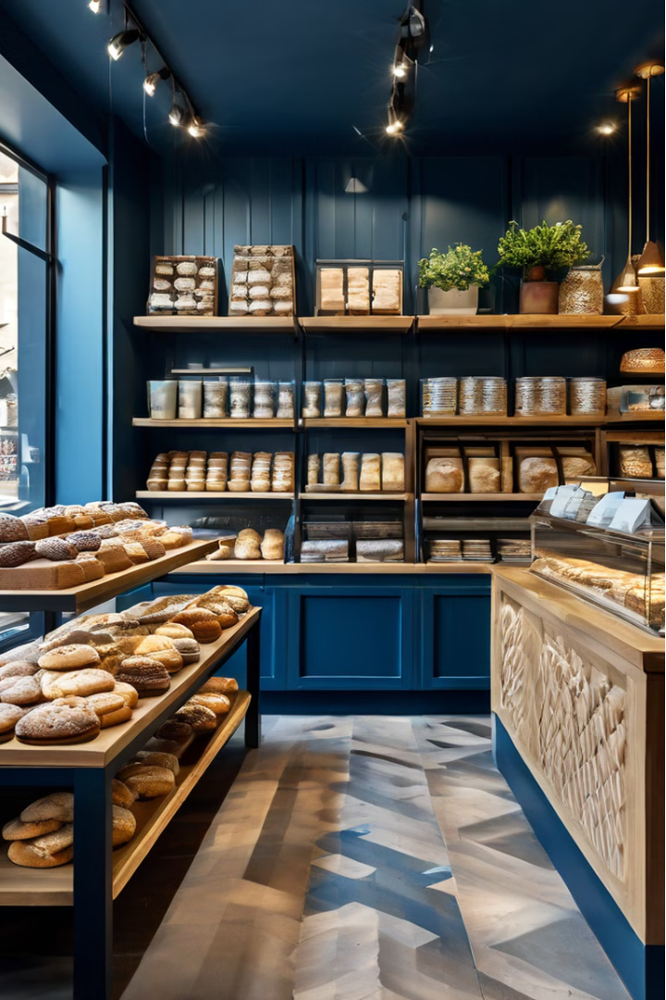


Local Cookies: A Bakery Heaven for Local Cookie Lovers
Local Cookies is a beloved bakery that specializes in crafting delicious, freshly baked cookies using locally sourced ingredients. Their commitment to quality and customer satisfaction has made them a go-to destination for cookie enthusiasts throughout the region.
by Local cookies

Slide 2
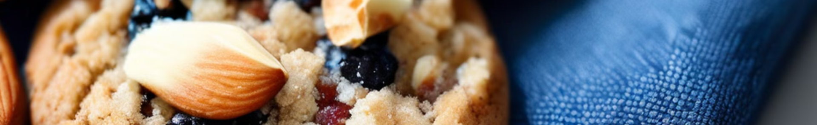

Healthy Cookie Options for Health-Conscious Customers
Wholesome Ingredients
Guilt-Free Indulgence
Nutritional Benefits
Their healthy cookies provide a delicious way for customers to satisfy their sweet cravings without compromising their dietary goals.
These cookies are packed with nutrients and fiber, making them a nutritious snack choice.
Local Cookies uses natural, unprocessed ingredients to create their healthy cookies options, catering to health-conscious customers.

Slide 3
Fresh Local Cookies in Sharjah
Locally Sourced
Daily Baking
Convenient Locations
Local Cookies sources all of their ingredients from local suppliers, ensuring the freshness and quality of their products.
The bakery's skilled team bakes a fresh batch of cookies every day, guaranteeing that customers always receive the highest quality treats.
With multiple locations throughout Sharjah, Local Cookies makes it easy for customers to access their delicious, freshly baked cookies.

Slide 4
Competing with Ben's Cookies in Popularity
1
Uncompromising Quality
2
Innovative Flavors
Local Cookies' commitment to using the best ingredients and traditional baking methods sets them apart from their competitors.
The bakery constantly introduces new and unique cookie flavors that keep customers coming back.
3
Exceptional Customer Service
4
Community Involvement
Local Cookies' friendly and knowledgeable staff provide an exceptional customer experience that keeps customers loyal.
The bakery's active participation in local events and initiatives has helped them build a strong connection with the community.

Slide 5
Best-Selling Chocolate Cookies
Rich, Decadent Cocoa
Melt-in-Your-Mouth Texture
Local Cookies' signature chocolate cookies are made with high-quality cocoa for an indulgent, chocolatey taste.
These cookies have a perfect balance of crisp edges and a soft, chewy center that satisfies any sweet tooth.
Flavor Variations
Customer Favorite
In addition to their classic chocolate cookies, the bakery offers unique flavor combinations like chocolate-hazelnut and double chocolate.
The chocolate cookies are consistently the most popular item on the bakery's menu, thanks to their irresistible taste and quality.

Slide 6




Commitment to Customer Satisfaction
Passion
Responsiveness
Consistency
Friendly Service
The team at Local Cookies is passionate about creating the best possible experience for their customers.
The bakery values customer feedback and works diligently to address any concerns or suggestions.
Customers can count on Local Cookies to deliver the same high-quality cookies with each visit.
The bakery's welcoming staff goes above and beyond to ensure customers have a pleasant experience.

Slide 7
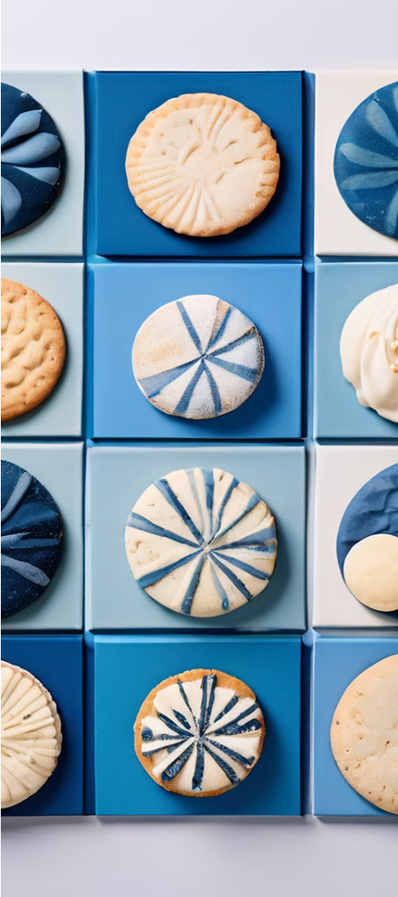

Variety of Cookie Flavors and Textures
1
Classic Flavors
Local Cookies offers timeless favorites like chocolate chip, oatmeal raisin, and peanut butter.
2
Seasonal Specials
The bakery introduces limited-time seasonal cookies to keep things fresh and exciting for their customers.
3
Unique Combinations
For the more adventurous palate, Local Cookies crafts innovative cookie flavors like matcha green tea and Earl Grey.

Slide 8
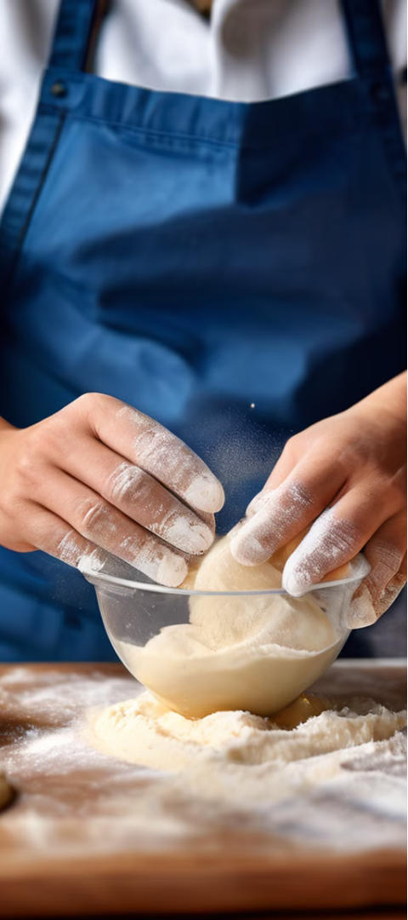



Locally Sourced Ingredients and Baking Techniques
Locally Sourced
Local Cookies sources all of their ingredients from trusted local suppliers, ensuring the freshness and quality of their products.
Traditional Baking
The bakery uses time-honored baking techniques to create their cookies, resulting in a perfect balance of crispness and chewiness.
Handcrafted
Each cookie is carefully handcrafted by the bakery's skilled team, who take pride in their work and attention to detail.

Slide 9
Contact Us
Phone:
971-65300115
Email:
Hello@localcookies.ae
Address:
Muwaileh Commercial –Industrial Area – Sharjah – United Arab Emirates

