Slide 1
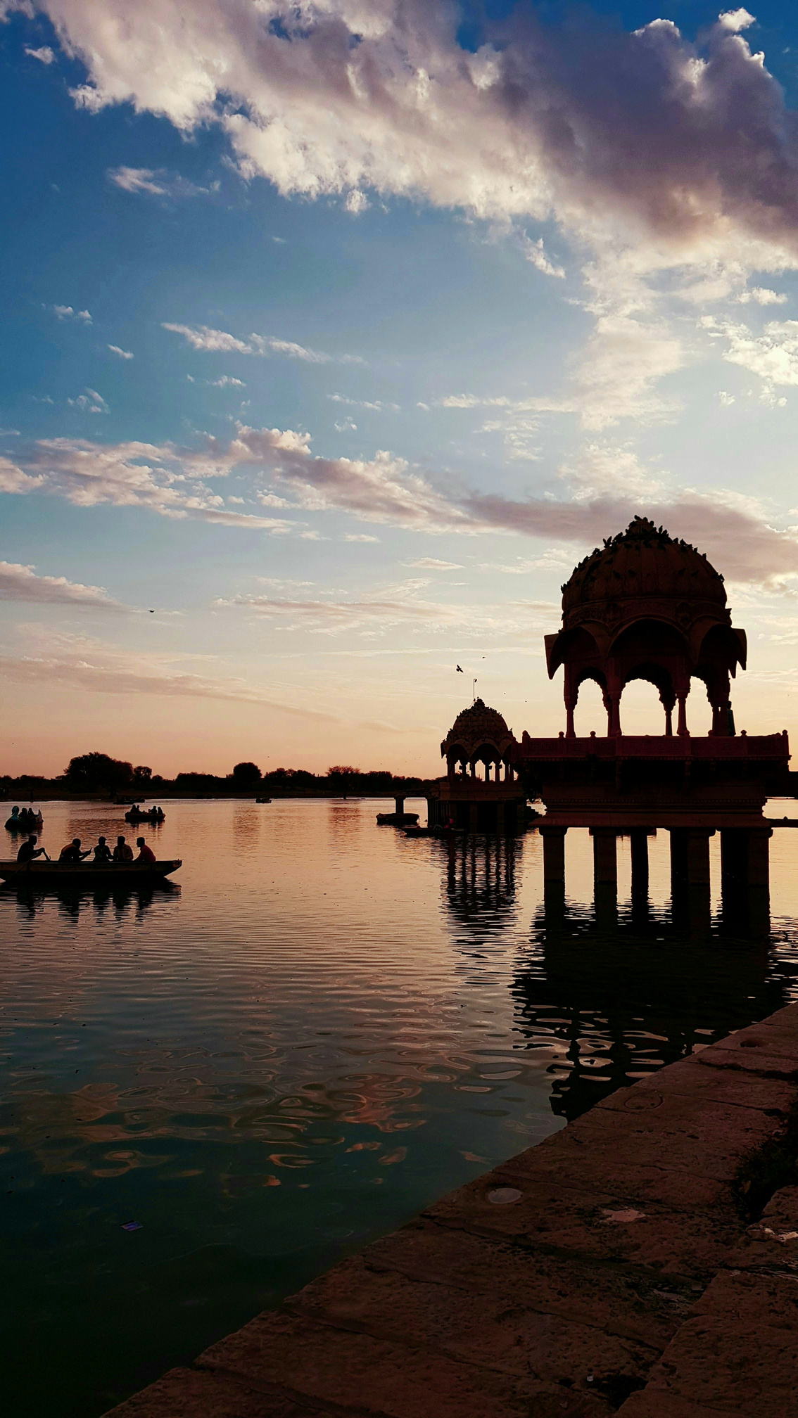

Best Cities to Visit with Friends in Rajasthan

Slide 2
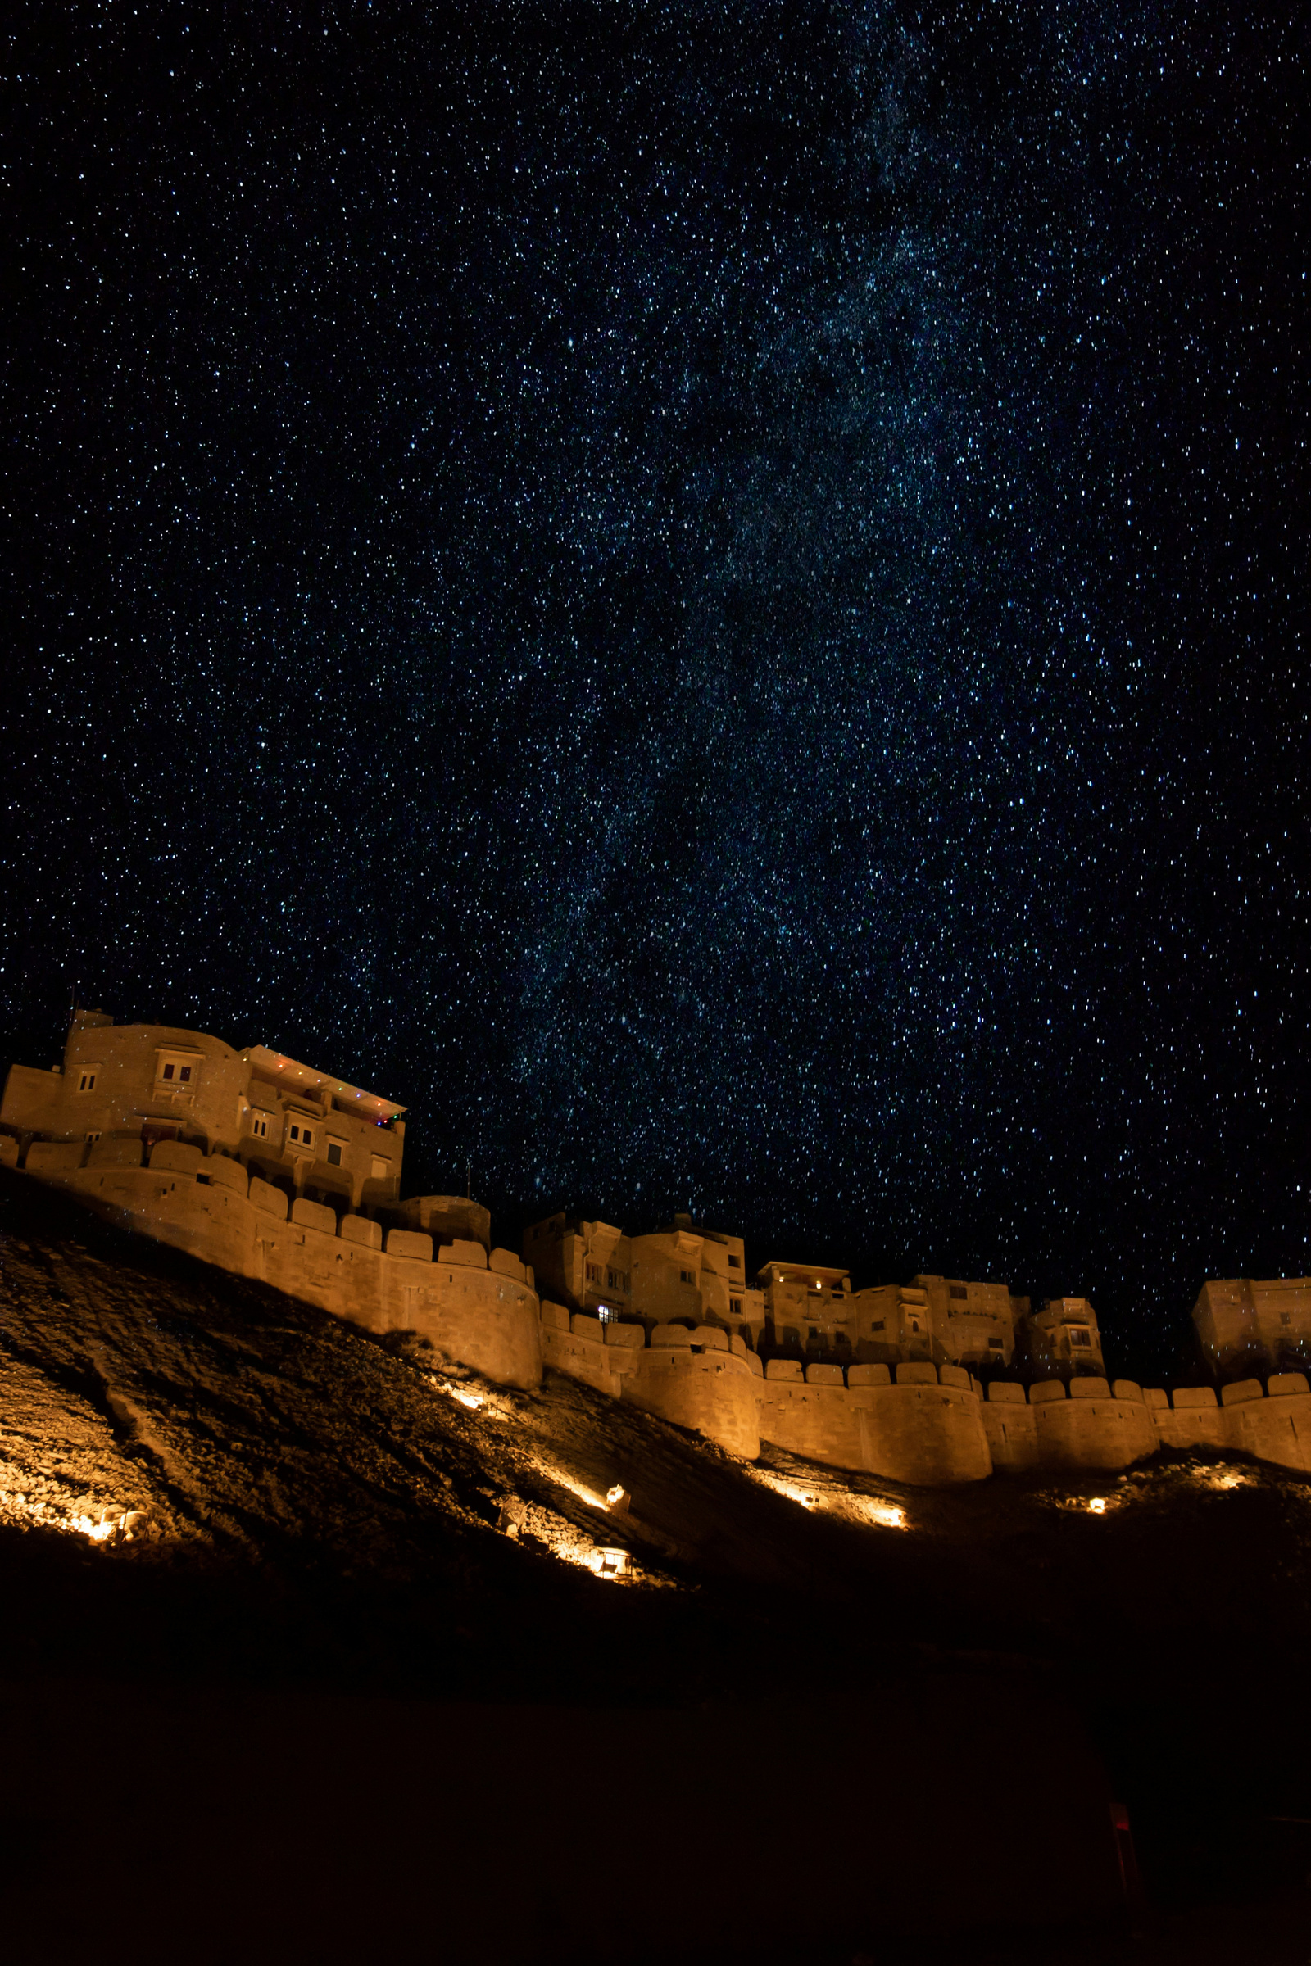
About Us
We hereby proudly introduce us as one of the leading Tempo Traveller Rental Company in Delhi providing all type of tempo, minibus on rent, large coach, car rental services and had left a smile on our client's face with our prompt service and reasonable rate Since 1999. Delhi Tempo Traveller (A unit of Sengar World Travels) is a best reviewed tempo traveller rental companies in Delhi. We offer our vehicle rental services for families, Corporate and tour groups in and around Delhi. Our business runs on a motive of safety insurance and client satisfaction at utmost priority. With years passing by, our clients have shown faith in us owing to our punctual service, friendly support staff, trained chauffeurs, and well maintained fleet of Tempo For families.

Slide 3
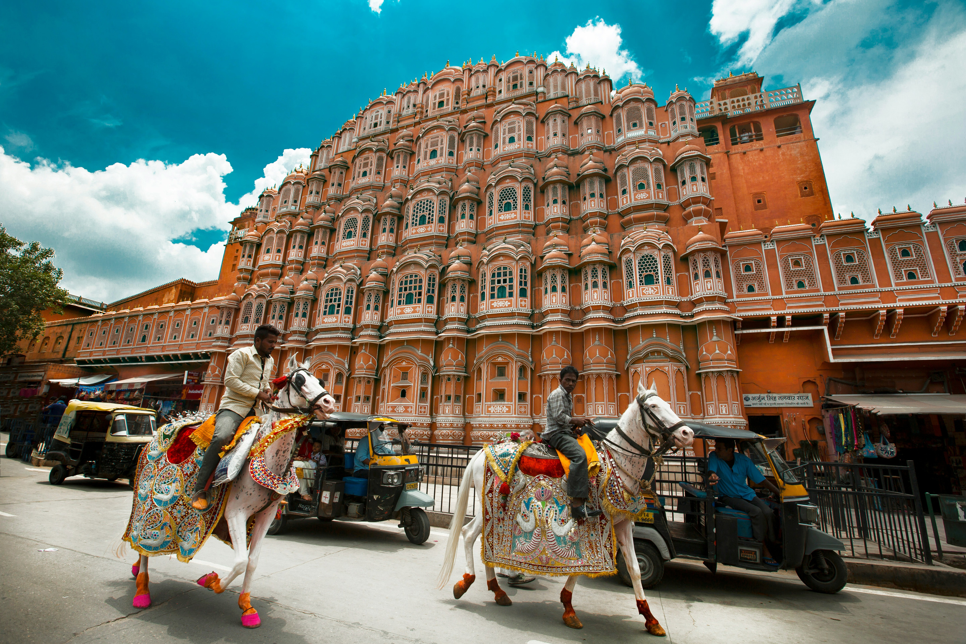
Jaipur
Jaipur is the perfect city to explore with your friends. You can Visit the amazing forts and palaces during the day, such as the Amer Fort, Nahargarh Fort, and City Palace. In the evening, head to popular spots like Chokhi Dhani for a traditional Rajasthani meal, or explore the bustling markets of Johari Bazaar and Bapu Bazaar for shopping. Book our Delhi to Jaipur Tour Package and enjoy this beautiful journey with your friends.

Slide 4
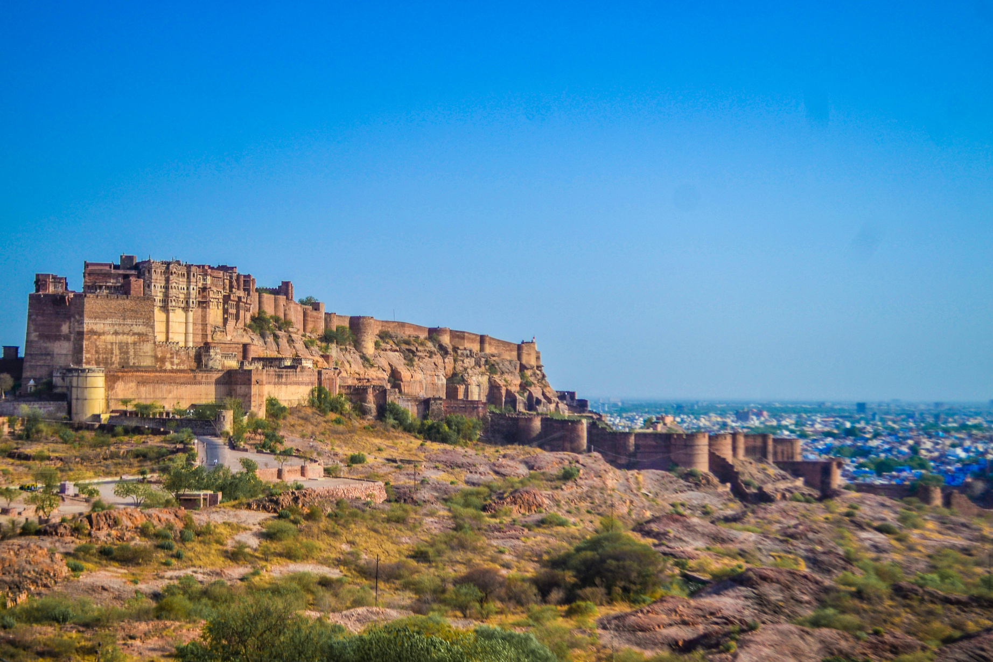
Jodhpur
Jodhpur is famous for its stunning architecture, bustling markets, and vibrant culture. Explore the Mehrangarh Fort, wander through the narrow lanes of the old city, and shop for handicrafts at the Sardar Market. For adventure, there are opportunities for zip-lining and desert safaris near Jodhpur.

Slide 5
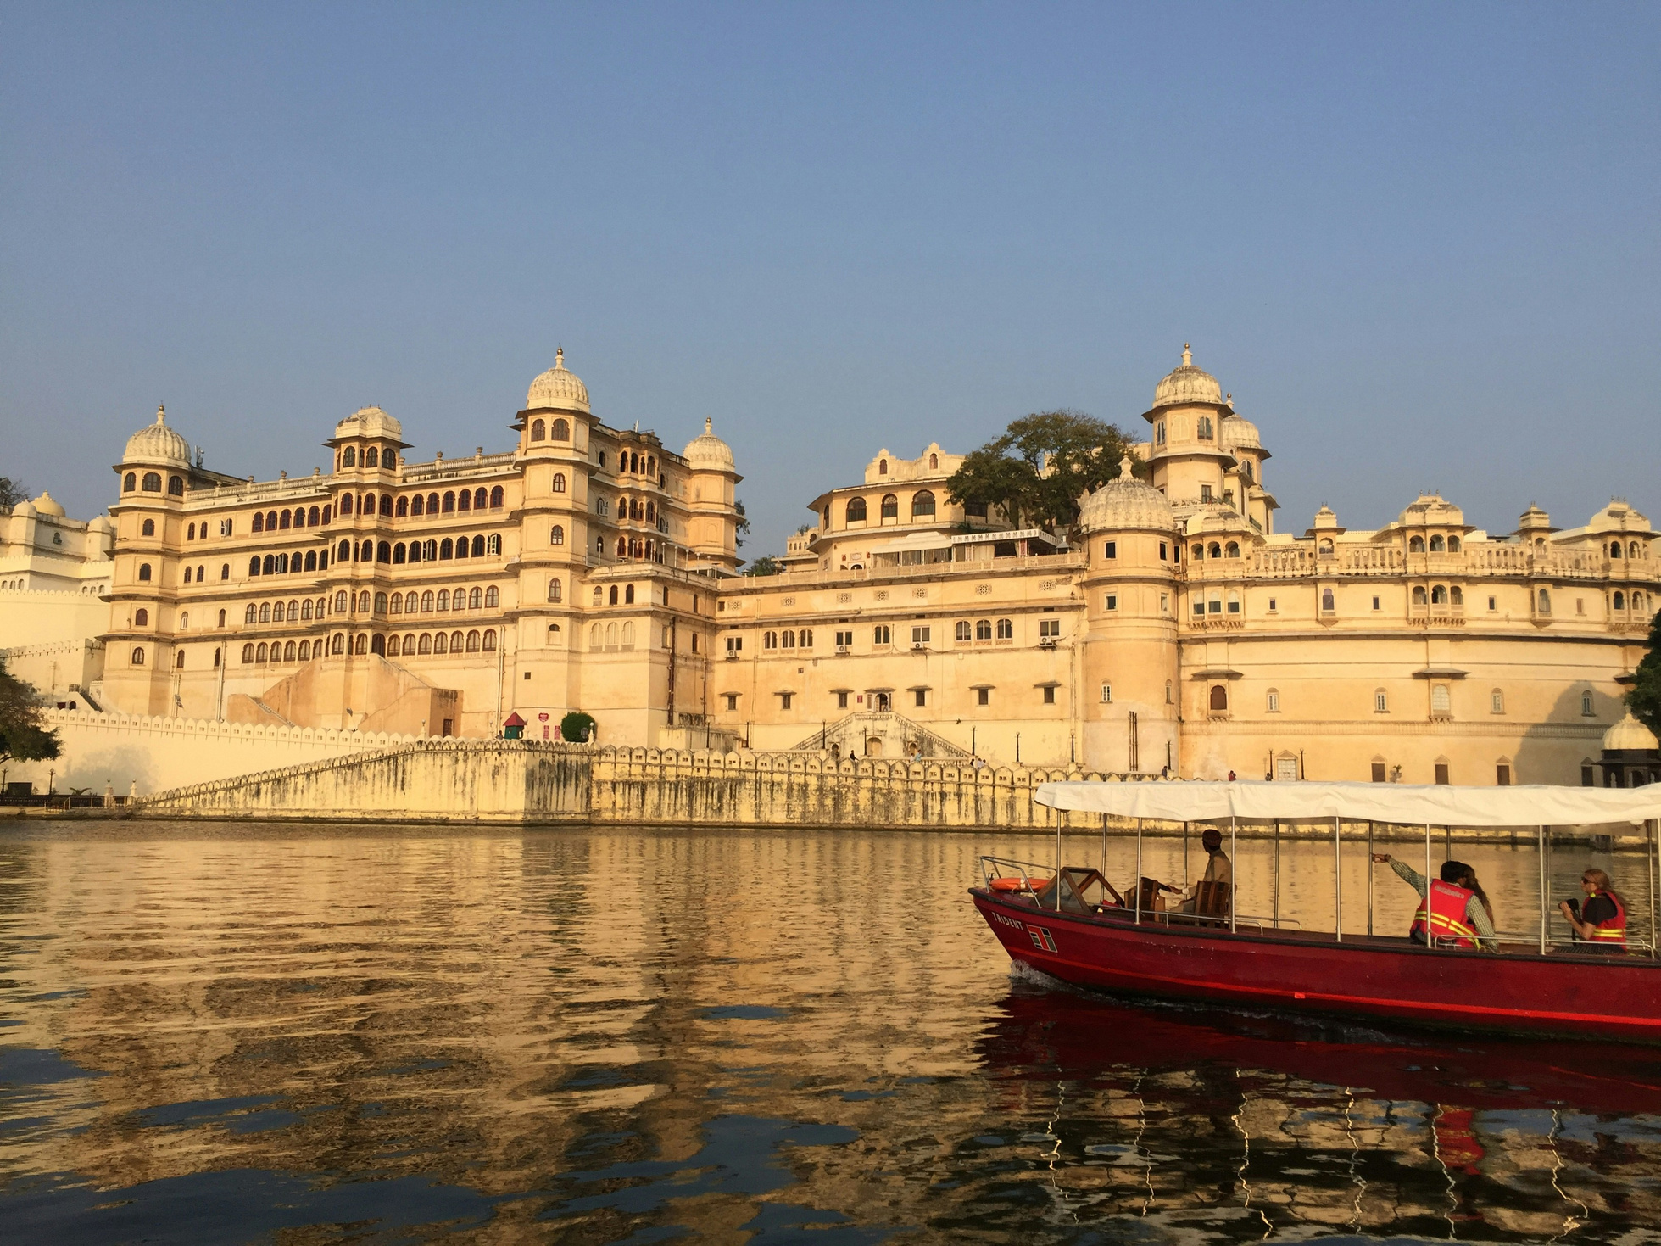
Udaipur
Udaipur is known for its romantic ambience and beautiful lakes. Explore the City Palace, take a boat ride on Lake Pichola to visit Jag Mandir Palace, and wander through the charming streets of the old city. Udaipur also offers plenty of opportunities for outdoor activities like horseback riding, trekking, and cycling around the countryside.

Slide 6
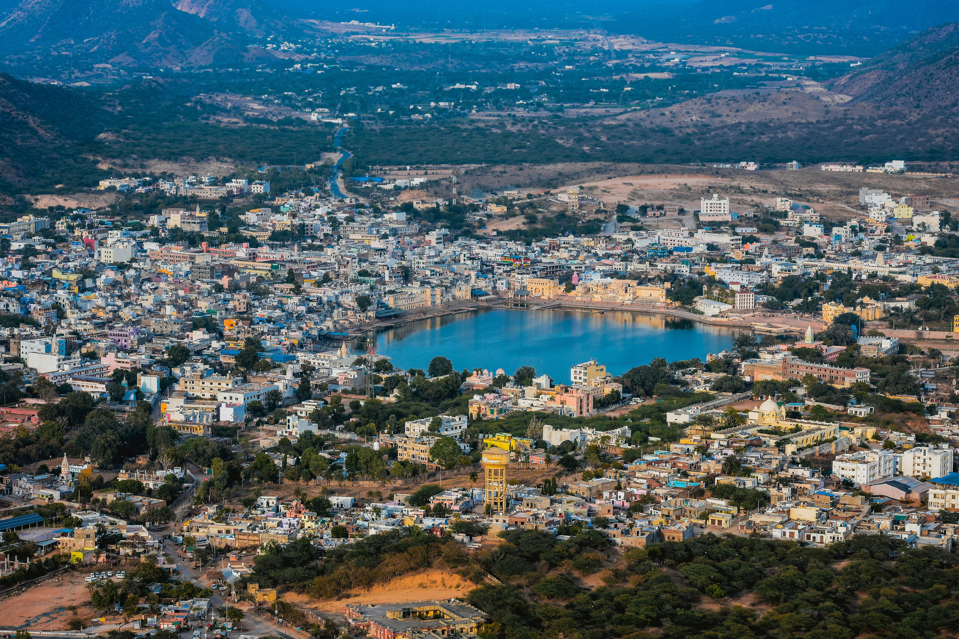
Pushkar is a vibrant town famous for its sacred lake and colourful markets. Visit the Brahma Temple, take a dip in the holy Pushkar Lake, and explore the bazaars filled with handicrafts, clothing, and jewellery. Do not miss the chance to experience the unique atmosphere of the Pushkar Camel Fair if you are visiting during the festival season.
Pushkar

Slide 7
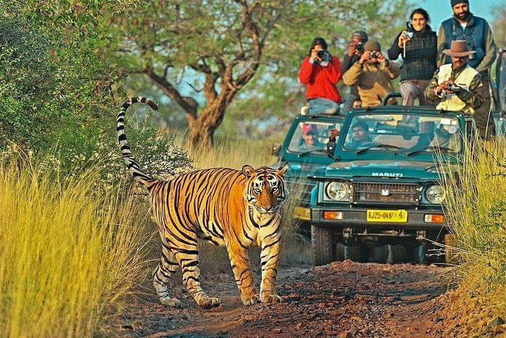
Ranthambore
If your group of friends then must try wildlife and adventure, for this Ranthambore is an ideal destination. Explore Ranthambore National Park on thrilling wildlife safaris to spot tigers, leopards, deer, and various bird species. You can also visit the historic Ranthambore Fort and enjoy outdoor activities like nature walks and birdwatching. Plan your next Rajasthan trip With our Rajasthan Tour Package.

Slide 8
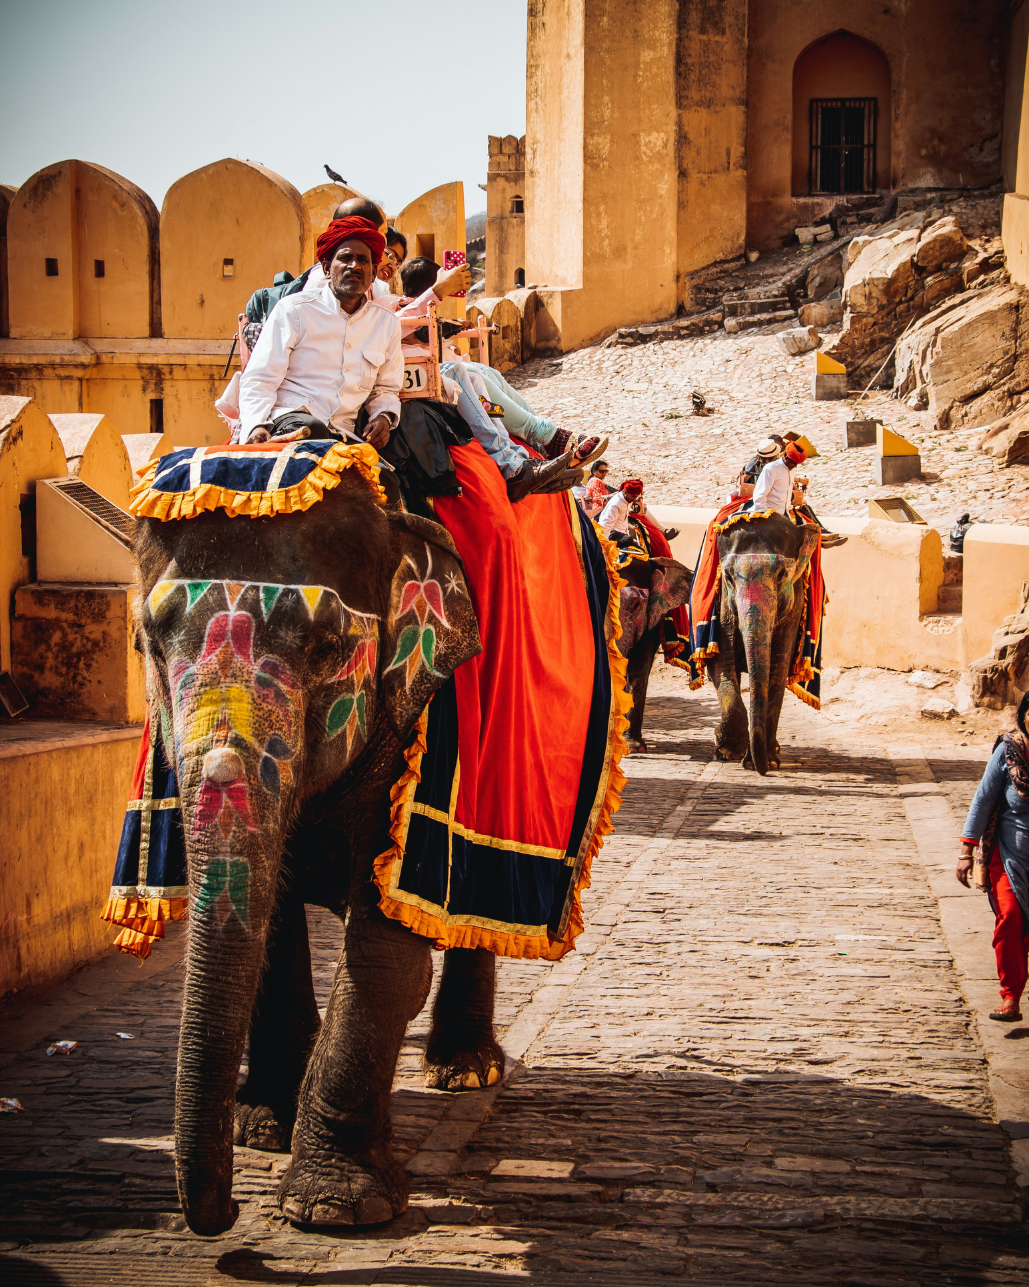
Book our Tempo Traveller Rent in Delhi for your Rajasthan Trip and explore beautiful Destinations like Jaipur, Udaipur, Jodhpur, Pushkar and Ranthambore. Discover these gems in Rajasthan with our comfortable and convenient transportation.

Slide 9
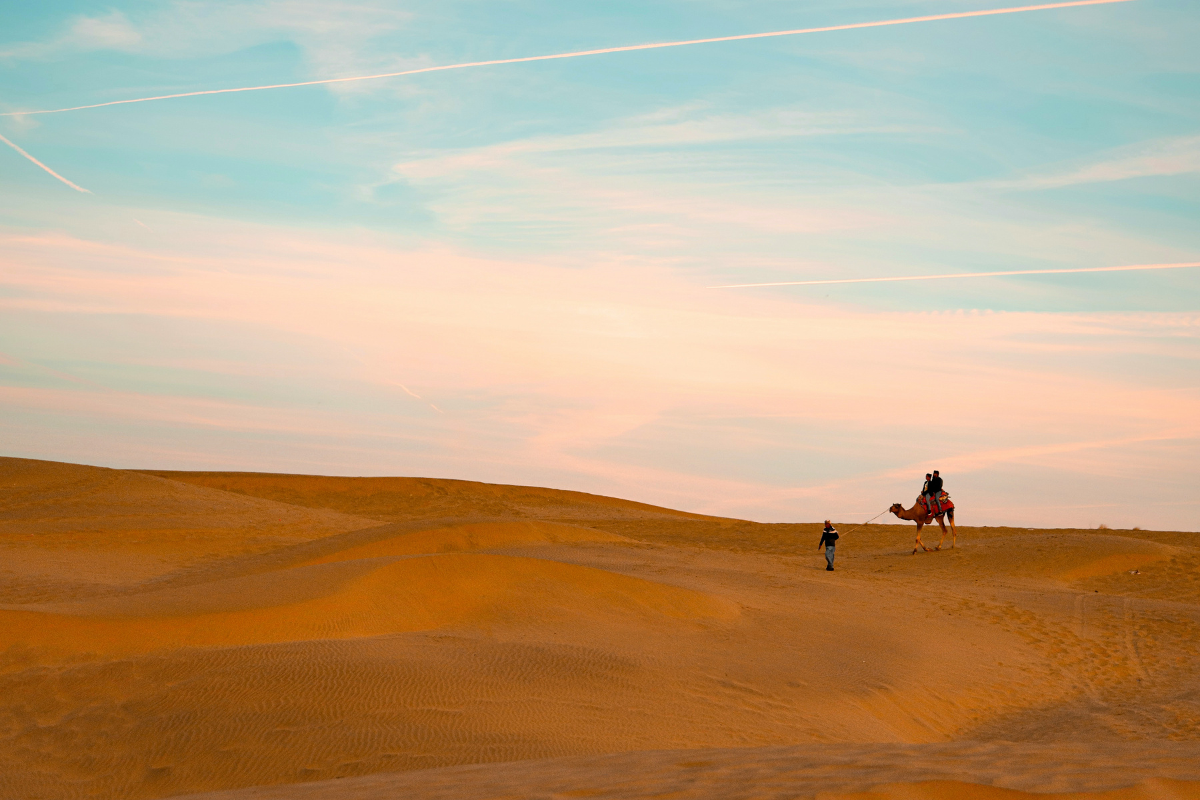
Thank You
Contact Us
+91-9013373931
Phone Number
info@delhitempotravels.com
Email Address
www.delhitempotravels.com
Website

