Slide 1
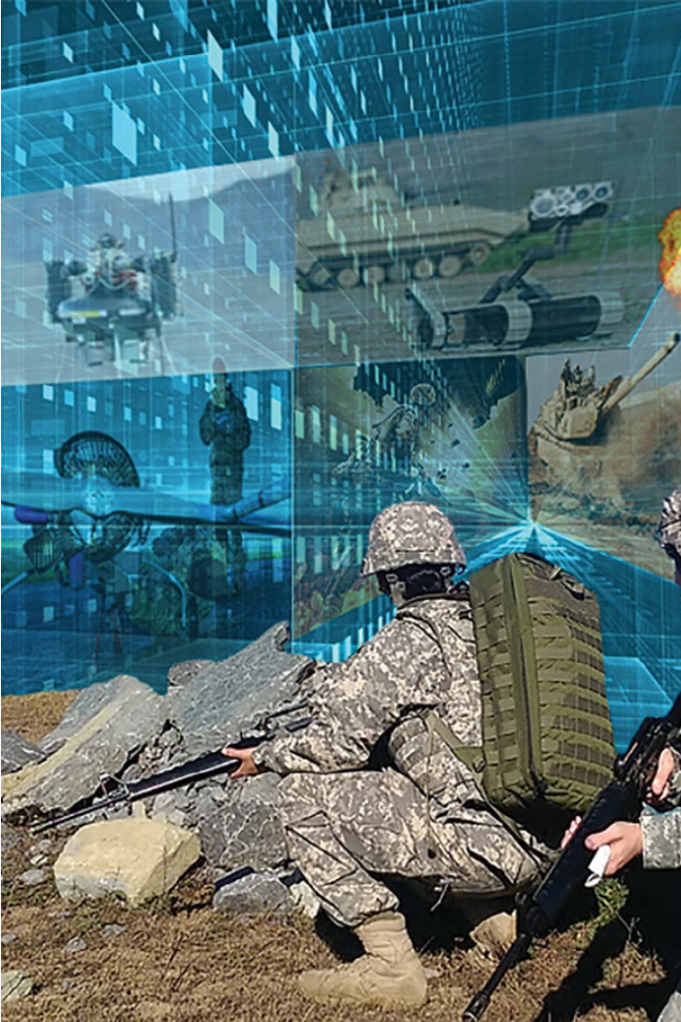

B2K Holdings: Your Trusted Defence Contractors
B2K Holdings is a leading Defence contractors that provides comprehensive solutions for all your defence and surveillance needs. With expertise in ground systems, airborne mission computers, and state-of-the-art displays and cameras, B2K is a reliable and innovative partner.

Slide 2
Comprehensive Defence Solutions
Ground Systems Expertise
Airborne Mission Computers
Robust Surveillance
B2K's suite of state-of-the-art NVIS displays, thermal cameras, and long-range camera systems provide reliable, high-performance surveillance capabilities.
B2K's advanced ground systems include specialized vehicles, communications equipment, and control centers to support a wide range of military operations.
Cutting-edge airborne mission computers from B2K enable real-time data processing, enhanced situational awareness, and mission-critical decision support for aircraft.

Slide 3
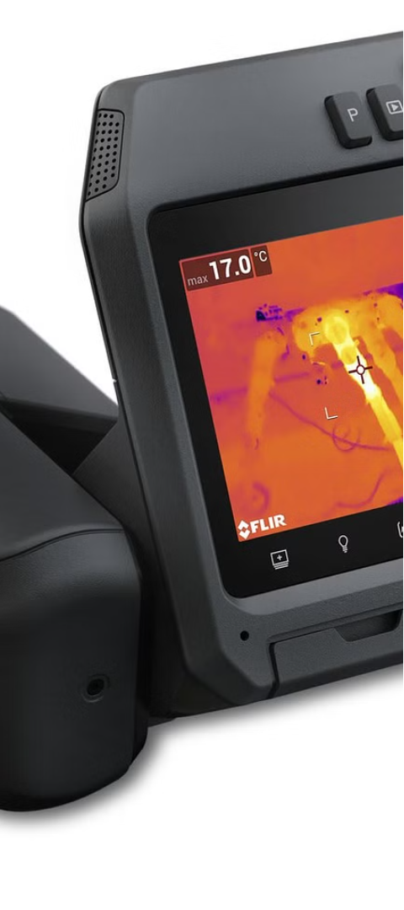
Tailored Surveillance Offerings
NVIS Displays
Thermal Cameras
B2K's state-of-the-art NVIS displays provide enhanced visibility and night-vision capabilities for military operations.
Cutting-edge thermal cameras from B2K enable reliable detection and tracking of targets in any lighting conditions.
Long-Range Cameras
B2K's long-range camera systems offer unparalleled surveillance coverage and high-resolution imagery for mission-critical applications.

Slide 4
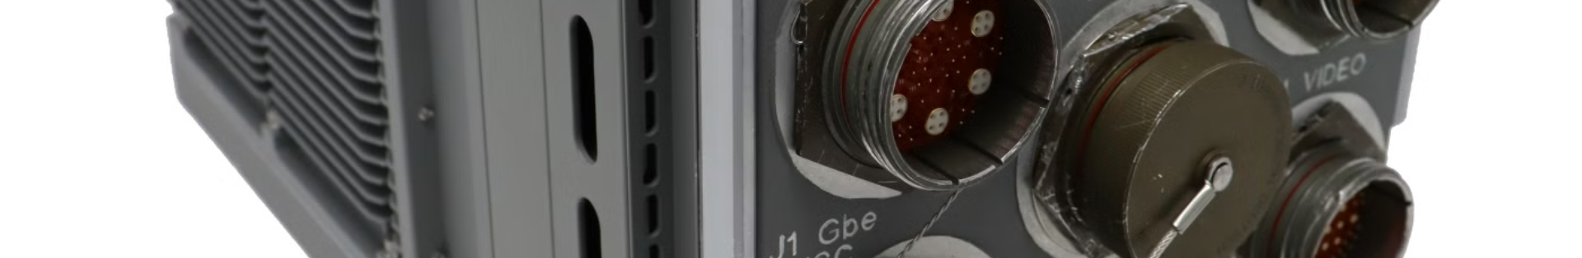


Airborne Mission Computers
1
Real-Time Data Processing
2
Enhanced Situational Awareness
3
Reliable Performance
B2K's airborne mission computers provide advanced data processing capabilities to support mission-critical decisions in the air.
Rugged and dependable, B2K's airborne mission computers are designed to withstand the rigors of military operations.
Integrating multiple sensor inputs, B2K's mission computers deliver a comprehensive, real-time picture of the operational environment.

Slide 5



State-of-the-Art NVIS Displays
Night Vision
Cockpit Integration
Rugged Design
B2K's NVIS displays provide enhanced visibility in low-light conditions, enabling mission success in challenging environments.
Seamlessly integrated into military aircraft, B2K's NVIS displays deliver critical information to pilots and crew.
Built to withstand the rigors of military operations, B2K's NVIS displays are durable and reliable.

Slide 6
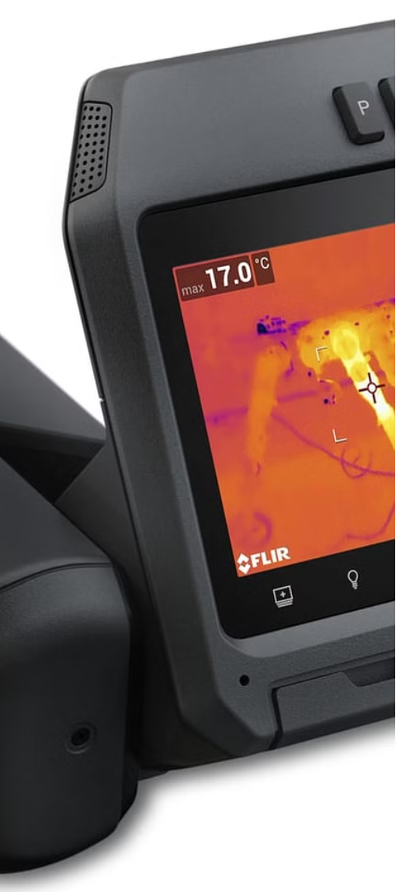

Cutting-Edge Thermal Cameras
1
Target Detection
B2K's thermal cameras provide reliable detection of targets in all lighting conditions, enhancing situational awareness.
2
Precision Tracking
Advanced algorithms and image processing allow B2K's thermal cameras to accurately track and monitor targets.
3
Operational Flexibility
Versatile mounting options and integration capabilities make B2K's thermal cameras adaptable to diverse mission requirements.

Slide 7
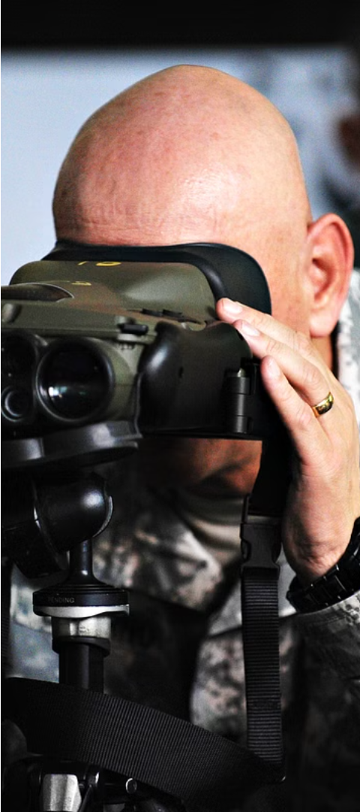



Long-Range Camera Systems
Unparalleled Coverage
B2K's long-range camera systems offer extensive surveillance capabilities, monitoring wide areas with exceptional clarity.
High-Resolution Imagery
Advanced optics and image sensors deliver detailed, high-quality imagery, enabling critical intelligence gathering.
Reliable Performance
Rugged and weatherproof, B2K's long-range camera systems operate reliably in challenging environmental conditions.

Slide 8
Tailored Surveillance Offerings
NVIS Displays
Thermal Cameras
Long-Range Cameras
Enhanced night vision capabilities
Reliable target detection and tracking
Extensive surveillance coverage and high-resolution imagery

Slide 9
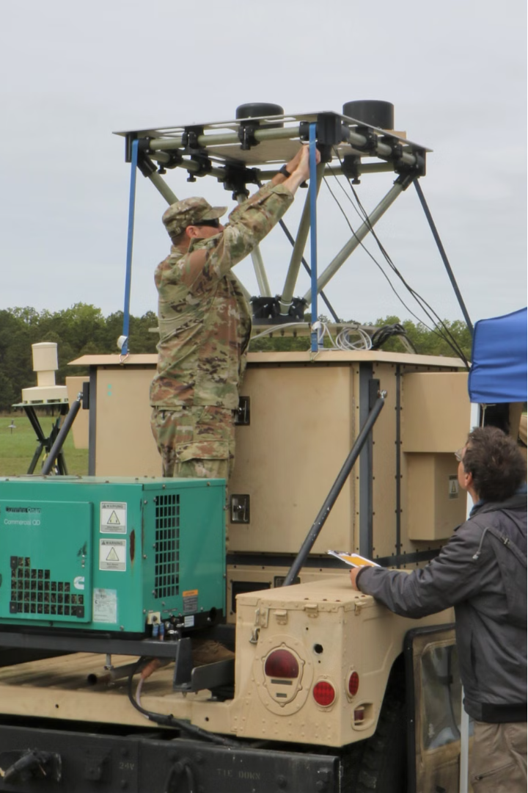
Reliable and Innovative Partner
As a trusted defense contractor, B2K Holdings delivers cutting-edge solutions and unparalleled expertise to support your mission-critical needs. With a commitment to innovation and reliability, B2K is your reliable partner in the field.

Slide 10

Know More
Britannia 2000 Holdings
Mobile: +44 7717 292751
Telephone: +44 1344 885058
Email: sales@b2kholdings.co.uk
Address: 4, Millside Park, Winkfield, Windsor SL4 4PX, United Kingdom

