Slide 1




EIKAEBANA FLOWER SHOP

Slide 2
ARTIFICIAL FLORA FOR HOME BLISS
ENHANCE YOUR LIVING SPACES
WITH FLOWERS AND PLANTS

Slide 3
WELCOME TO EIKAEBANA
your go-to source for exquisite artificial flowers and plants that enhance any home decor. Our carefully curated collection includes artificial flowers for home decoration and artificial plants for home decor, offering endless possibilities for elevating your living spaces with beauty and style. Explore our wholesale options and discover the perfect blooms and foliage to adorn your home with effortless elegance.

Slide 4
At Eikaebana, we recognize the importance of creating a cozy and welcoming ambiance in your home.
ARTIFICIAL FLOWERS FOR HOME DECORATION
That's why we present a stunning selection of artificial flowers for home decoration, meticulously designed to enrich any room with their lifelike allure.
From traditional roses to vibrant orchids, our artificial blooms infuse color and sophistication into your living spaces, sans the upkeep.
TRANSFORM YOUR SPACE WITH TIMELESS ELEGANCE

Slide 5
Whether you're seeking a captivating centerpiece for your dining table or a romantic touch for your bedroom, our artificial flowers offer the ideal solution. With their realistic appearance and enduring freshness, you can relish the beauty of fresh flowers year-round, minus the concerns of wilting or fading.
MAY

Slide 6
In addition to our captivating array of artificial flowers, Eikaebana boasts an extensive variety of artificial plants for home decor. From verdant foliage to lifelike succulents, our artificial plants bring the serenity of nature into your home, devoid of the need for watering or sunlight. Perfect for infusing any room with a touch of greenery, our artificial plants are versatile accents that harmonize with any decorating motif.
Artificial Plants for Home Decor: Embrace Nature's Beauty Indoors

Slide 7
Whether you're fashioning a botanical display for your living room or imparting a fresh vibe to your kitchen, our artificial plants provide the perfect answer. With their authentic textures and vibrant hues, our plants introduce depth and vitality to your decor, creating an inviting atmosphere in any space.

Slide 8
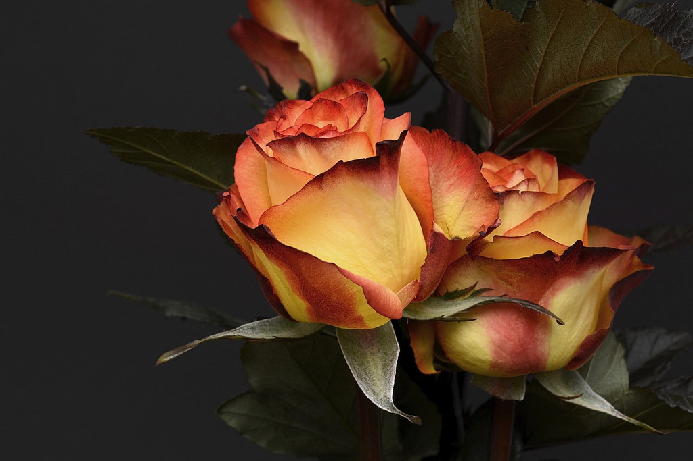
ARTIFICIAL SILK FLOWERS WHOLESALE: EXCEPTIONAL QUALITY AND VALUE
At Eikaebana, we are dedicated to furnishing our customers with top-tier artificial flowers and plants at wholesale prices. Our artificial silk flowers wholesale options deliver unparalleled value, enabling you to stock up on your preferred blooms and plants without straining your budget. Whether you're a seasoned decorator, event planner, or home enthusiast, our wholesale choices simplify the pursuit of beauty and elegance.

Slide 9
Our wholesale range encompasses a diverse selection of artificial flowers and plants, ensuring you find the perfect pieces to realize your decorating vision. From opulent bouquets to verdant arrangements, our wholesale offerings cater to every preference and budget.

Slide 10
CONCLUSION
Eikaebana stands as your ultimate destination for artificial flowers and plants that elevate your home decor with grace and flair. Whether you're seeking artificial flowers for home decoration, artificial plants for home decor, or wholesale options, we provide everything you need to fashion a breathtaking living space that mirrors your distinct style. Discover the essence of Eikaebana today and uncover why we are the preferred choice for discerning homeowners everywhere.

Slide 11
THANK YOU
www.shop.eikaebana.com

