Slide 1
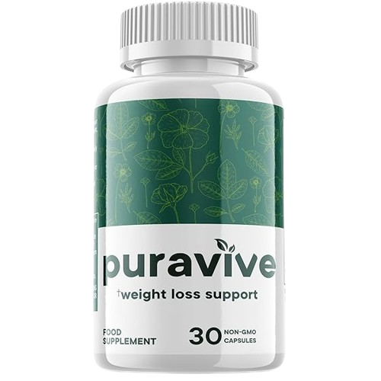
Puravive: Revolutionizing Weight Management
Harnessing the Power of Brown Fat for Effective Weight Loss

Slide 2
Introduction
🔥Highlight the significance of addressing reduced brown fat for weight management.
🔥 Brief overview of the presentation structure.

Slide 3
Understanding the Core Issue
🔥 Explain the significance of brown fat in weight management
🔥 Discuss how reduced brown fat contributes to unexplained weight gain
🔥 Introduce Puravive as a solution targeting this core issue

Slide 4
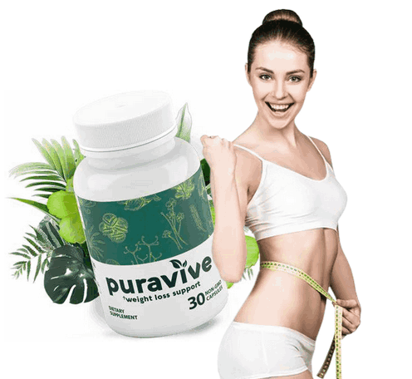
The Science Behind Puravive
🔥 Explore the mechanism of action of Puravive
🔥 Explain how Puravive stimulates the activation and production of brown fat
🔥 Highlight the scientific research supporting the efficacy of Puravive

Slide 5
Key Benefits of Puravive
🔥 Discuss the benefits of Puravive for weight management
🔥 Emphasize its effectiveness for both men and women
🔥 Highlight any additional health benefits associated with Puravive consumption

Slide 6
Clinical Studies and Results
🔥 Present the findings of clinical studies conducted on Puravive
🔥 Showcase any statistically significant results regarding weight loss and brown fat activation
🔥 Provide visuals or graphs to support the data presented

Slide 7
User Testimonials
🔥 Share testimonials from individuals who have tried Puravive
🔥 Highlight personal experiences, satisfaction, and successful weight loss stories
🔥 Include before-and-after pictures if available

Slide 8
How to Incorporate Puravive into Your Routine
🔥 Provide guidance on how to use Puravive effectively
🔥 Offer tips for integrating Puravive into daily lifestyle and dietary habits
🔥 Emphasize the importance of consistency for optimal results

Slide 9
Safety and Side Effects
🔥 Address any potential safety concerns associated with Puravive
🔥 Discuss possible side effects and how to mitigate them
🔥 Reassure the audience of Puravive's safety profile based on research and user experiences

Slide 10
Conclusion
🔥 Summarize the key points discussed throughout the presentation
🔥 Reiterate the significance of Puravive in addressing reduced brown fat for weight management
🔥 Encourage the audience to consider Puravive as a viable solution for their weight loss journey

