Slide 1
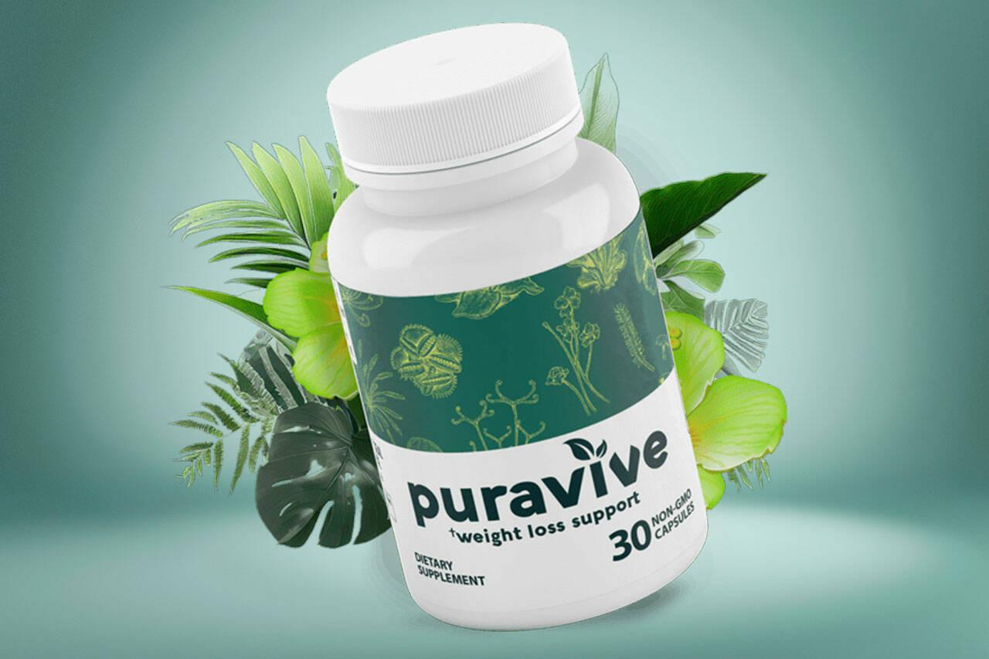
Puravive: Revolutionizing Weight Management
Harnessing the Power of Brown Fat for Effective Weight Loss

Slide 2
Introduction
⚓ Introduction to Puravive
⚓ Explanation of Brown Fat and its Role in Weight Management

Slide 3
Understanding the Problem
⚓ Unexplained Weight Gain: Reduced Brown Fat Levels
⚓ Impact of Reduced Brown Fat on Metabolism
⚓ Challenges in Traditional Weight Loss Approaches

Slide 4
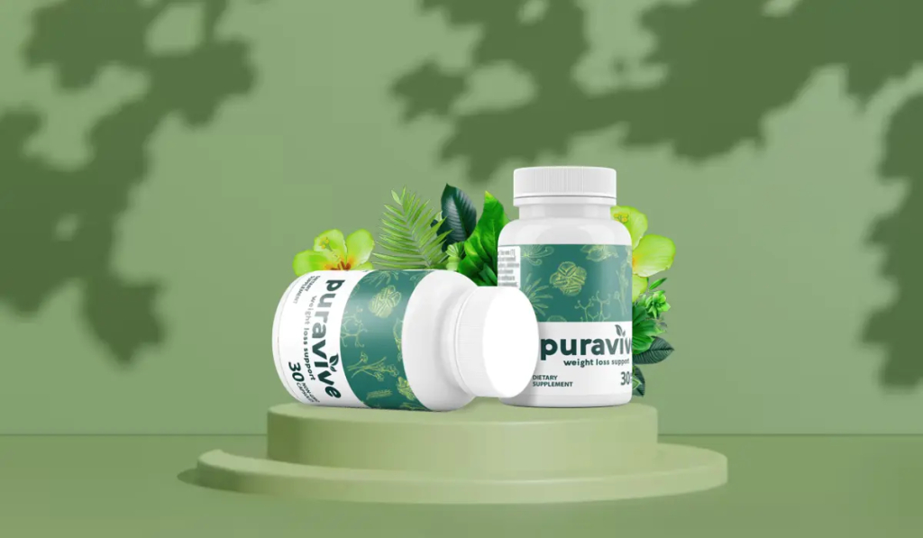
Puravive Solution
⚓ Puravive: Addressing the Root Cause
⚓ Activating Brown Fat for Enhanced Metabolism
⚓ Scientifically Proven Ingredients

Slide 5
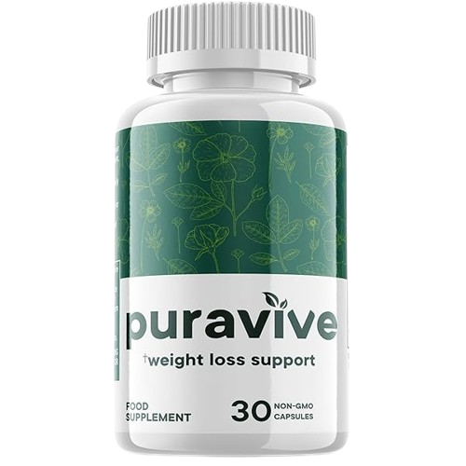
How Puravive Works
⚓ Mechanism of Action
⚓ Increasing Brown Fat Activity
⚓ Boosting Metabolic Rate

Slide 6
Benefits of Puravive
⚓ Effective Weight Loss for Men and Women
⚓ Sustainable Results
⚓ Improved Metabolic Health

Slide 7
Clinical Evidence
⚓ Clinical Studies Supporting Puravive's Efficacy
⚓ Results and Findings
⚓ Testimonials from Satisfied Users

Slide 8
Safety and Side Effects
⚓ Safety Profile of Puravive
⚓ Minimal Side Effects
⚓ Suitable for Long-Term Use

Slide 9
How to Use Puravive
⚓ Dosage Instructions
⚓ Best Practices for Optimal Results
⚓ Incorporating Puravive into Daily Routine

Slide 10
Conclusion
⚓ Recap of Puravive's Benefits
⚓ Call to Action: Start Your Weight Loss Journey Today
⚓ Contact Information for Further Inquiries

