Slide 1
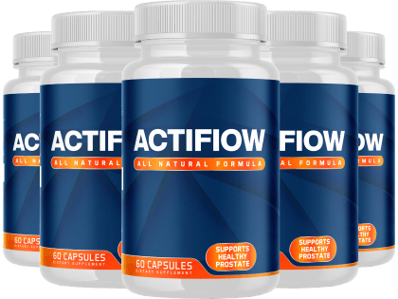
Unlocking the Fountain of Youth with ActiFlow:
A Comprehensive Guide

Slide 2
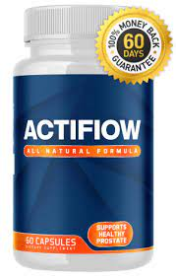
Introduction
As one's body undergoes aging, certain changes take place that are inevitable. Although some individuals may acquire distinguished and mature-looking wrinkles, they might also encounter difficulties such as muscle mass loss and weight gain.
These changes often lead to a desire for effective solutions that not
only address the visible signs of aging but also promote overall
well-being. In recent years, one breakthrough technology has gained
attention for its potential in enhancing vitality and reversing some
age-related changes – ActiFlow.

Slide 3
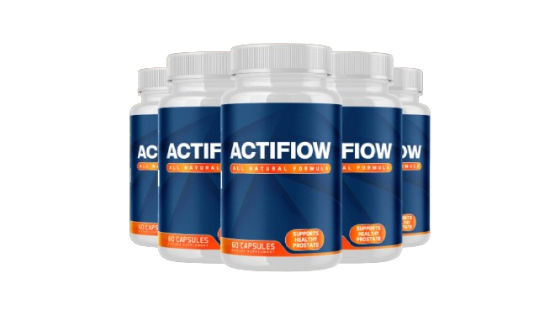
What is ActiFlow?
Actiflow is a revolutionary dietary supplement specifically designed to address the physiological changes that accompany aging, particularly in men. Crafted with a blend of carefully selected natural ingredients, Actiflow aims to support various aspects of men's health, from boosting energy levels and maintaining muscle mass to aiding in weight management. Unlike conventional approaches, Actiflow offers a holistic solution that targets multiple facets of aging simultaneously, providing a comprehensive strategy for individuals looking to maintain their vitality as they grow older.
If Actiflow is a specific product or brand, I recommend checking the official website, product label, or contacting the manufacturer directly for the most accurate and up-to-date information. Additionally, you may want to look for customer reviews, testimonials, or scientific studies related to Actiflow to gain insights into its effectiveness and benefits. Always consult with healthcare professionals before starting any new supplement regimen to ensure it aligns with your individual health needs and any pre-existing conditions.

Slide 4
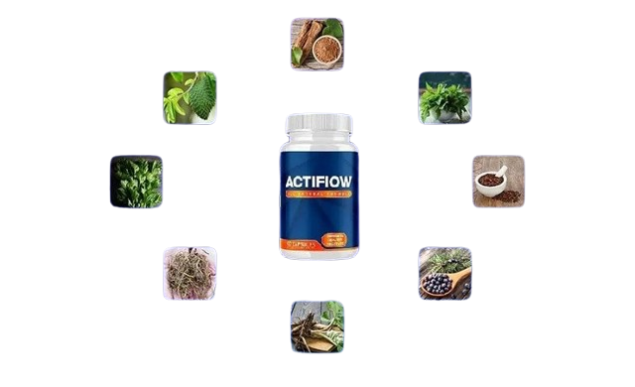
Ingredients
Soursop leaf : soursop leaf has been a staple in traditional medicine for centuries and is still used today due to its efficacy in addressing certain male health issues.
Cat's claw bark : Cat’s claw bark is included in Actiflow's formula primarily for its ability to eliminate toxins from the body, reducing the risk of inflammation and preventing damage caused by free radicals.
stinging nettle leaf : stinging nettle leaf is commonly used as a natural treatment for BPH, a condition marked by prostate gland inflammation.
Burdock Root: ActiFlow contains burdock root as a key ingredient, known for its rich antioxidants content.
Goldenseal root has been a popular ingredient in traditional medicine for male wellness for a long time.
Juniper Berry: ActiFlow includes juniper berry, a natural fruit that helps protect against prostate infections, prevent hair loss, and enhance libido.
Buy Actiflow

Slide 5
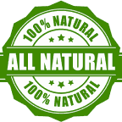


Why Choose Actiflow?
Quality Tested
To ensure that the information on the label matches the actual contents of the bottle, the product undergoes testing
Made In The USA
The production of this product takes place in a facility based in the United States.
FDA Approved Facility
The product is manufactured in an FDA-approved facility that maintains high standards of sterility.
Buy now

Slide 6

100% Satisfaction
60-Day Money Back Guarantee
ActiFlow offers a fantastic money-back guarantee that allows customers to receive a full refund within 60 days if they are not satisfied with the product's results. This policy provides peace of mind, ensuring that customers won't feel like they have wasted their money if they don't see the desired outcomes.

