Slide 1
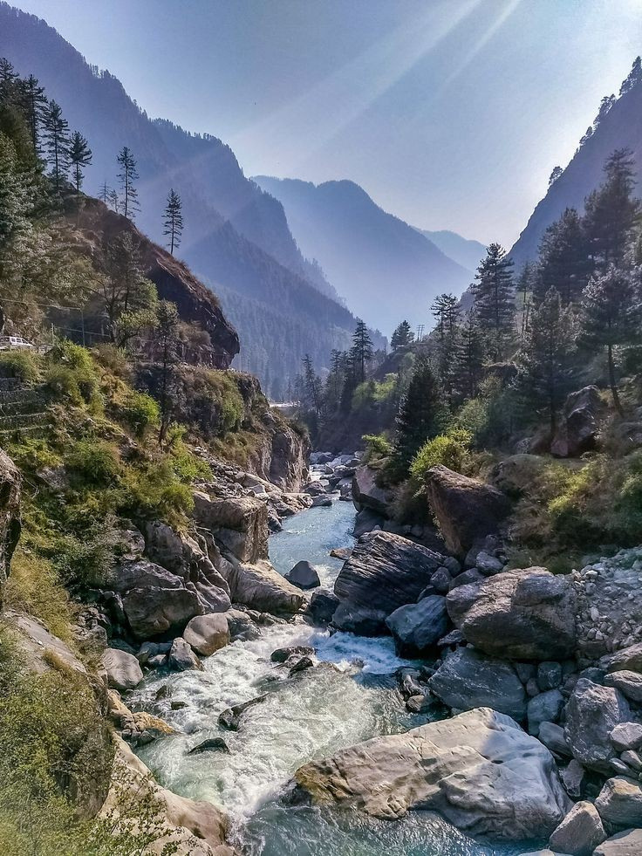


OFF BEAT PLACES TO VISIT IN NORTH INDIA

Slide 2
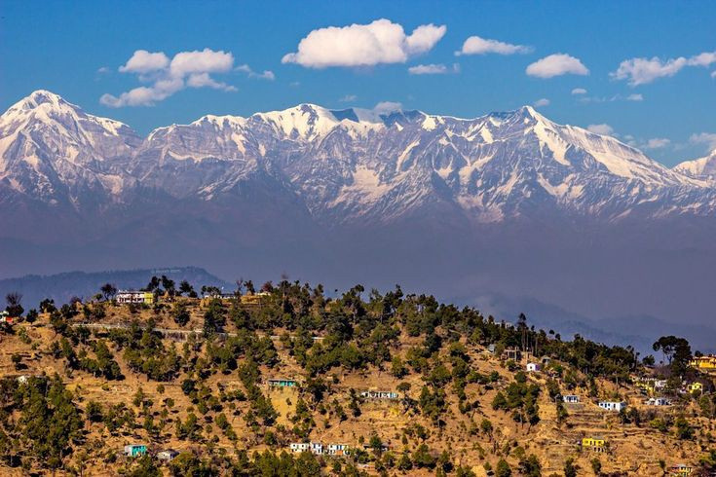

Binsar, Uttarakhand
Binsar is a quiet town located in the Kumaon region. It offers panoramic views of the Himalayas and is known for its wildlife sanctuary, ancient temples, and trekking trails.

Slide 3
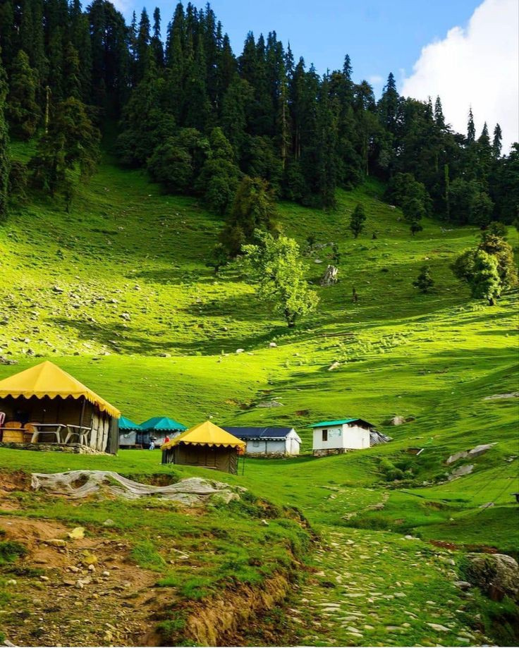
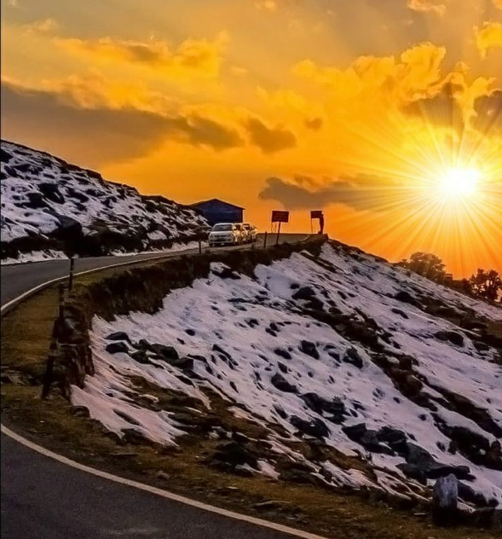
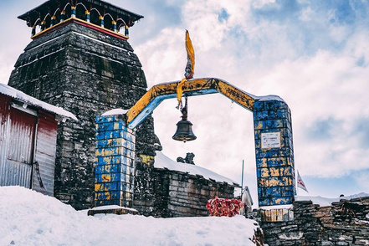
Chopta, Uttarakhand
It is Known as the "Mini Switzerland" of India. Chopta is a peaceful hill station known for its meadows and breathtaking views of the Himalayas. It's a base for the trek to Tungnath, the highest Shiva temple in the world.

Slide 4
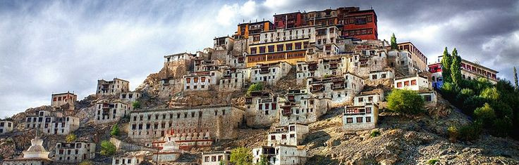
Hemis is known for the Hemis Monastery, the largest and wealthiest monastery in Ladakh. The two day Hemis Festival where you can experience the Ladakh culture is one of the main attractions here and it also makes for a great place for wildlife lovers, thanks to the Hemis National Park. The snow leopard which is an endangered species can be seen at the National Park.
Hemis, Ladakh

Slide 5
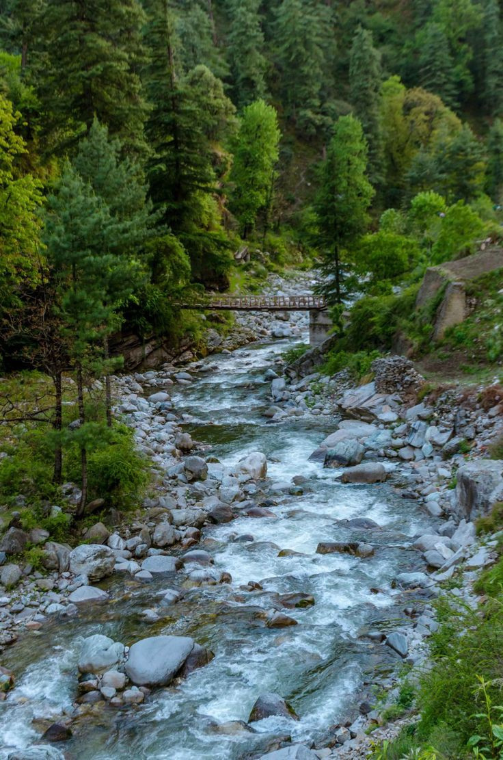
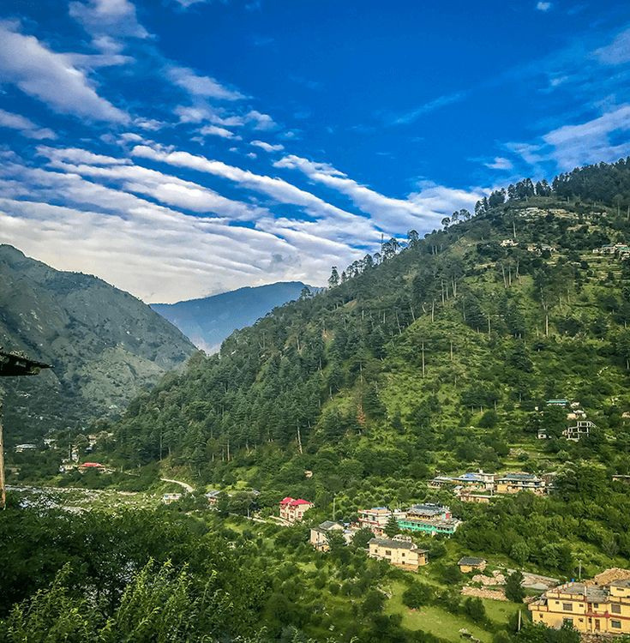
Tirthan Valley, Himachal Pradesh
Tirthan Valley in Kullu is well worth the drive from Delhi, as it is so offbeat that apart from the locals you are unlikely to come across many tourists. The attractions here include trekking, bird watching, wildlife, and angling. The place also has some waterfalls and riverside camping spots. Book Himachal tour by car to enjoy this scenic place.

Slide 6
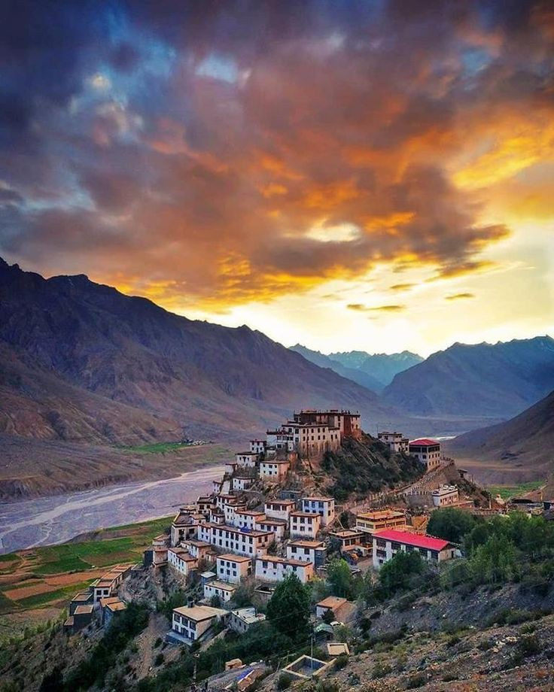
Spiti Valley, Himachal Pradesh
Spiti Valley is a high-altitude desert mountain valley located in the Himalayas. It's known for its stark landscapes, ancient monasteries, and vibrant Buddhist culture. The region offers opportunities for trekking, camping, and exploring Buddhist heritage. The pristine nature will definitely make you fall in love with Spiti valley.

Slide 7
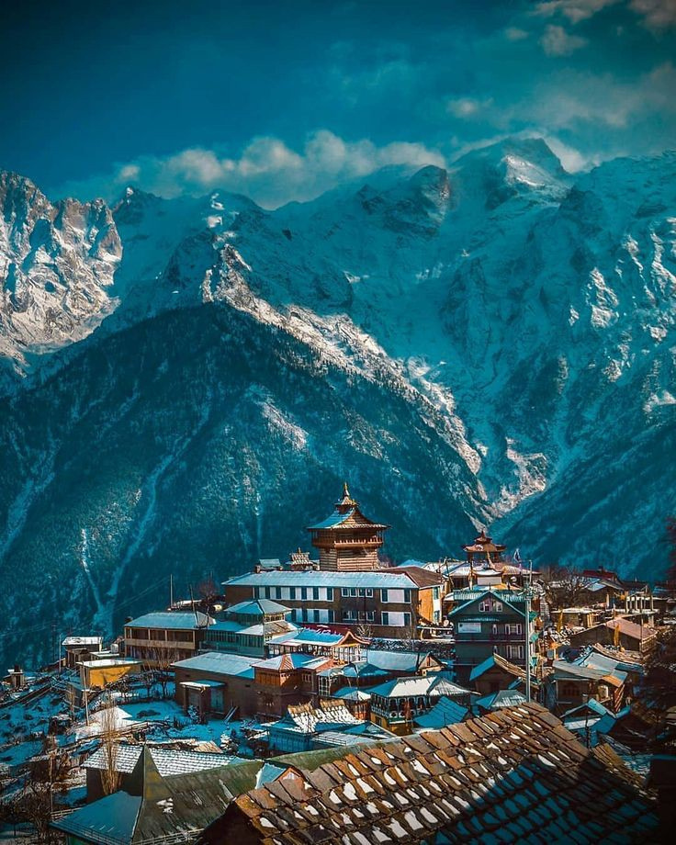
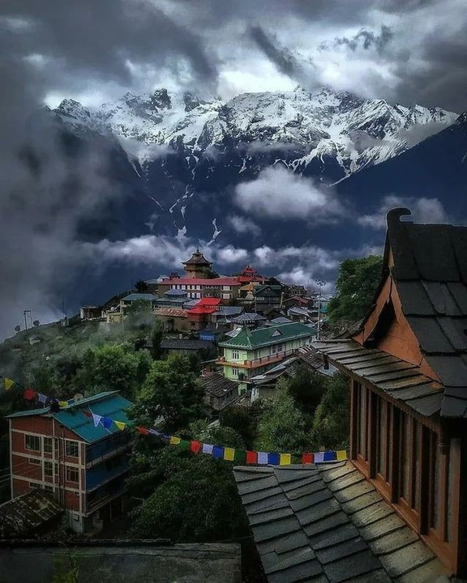
Kalpa, Himachal Pradesh
Nestled in the Kinnaur district, Kalpa is known for its apple orchards and stunning
landscapes. The town provides breathtaking views of the Kinner Kailash range.

Slide 8
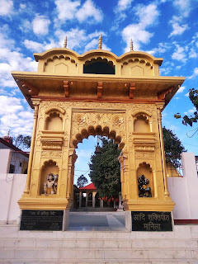
Manila, Uttarakhand
This tiny village is a bit obscure but has a grand view of the peaks such as Nanda Devi, Trishul, and Panchchulli. The sleepy place turns golden with the rising and setting sun and the natural beauty is enough to render you speechless. The place is also popular for Maa Manila Temple. There have never been any offbeat destinations in North India as serene and peaceful as Manila.

Slide 9
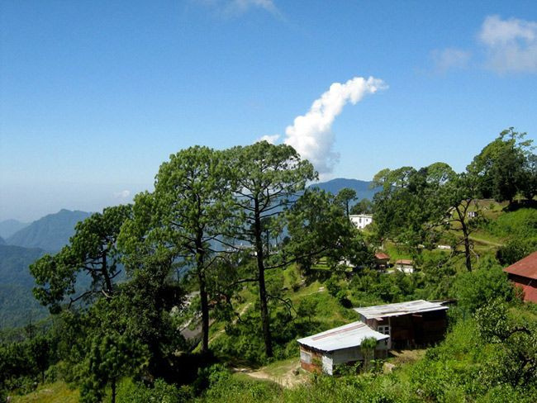
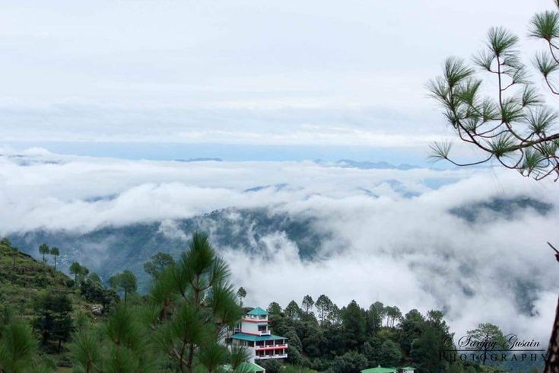
Lansdowne, Uttarakhand
Lansdowne is one of the unexplored tourist places near Delhi NCR, which has recently received much limelight. This destination is perfect for those, who are seeking a lazy holiday. From strolling around to trekking, from boating to sightseeing, you can indulge in many things.

Slide 10

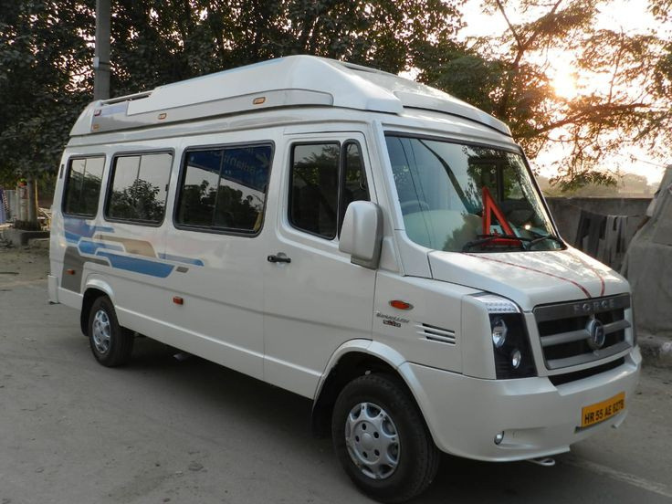
Hire Tempo Traveller fo your Journey
Hire a tempo traveller in Delhi for North India tour and explore offbeat North Indian destinations like Binsar, Chopta, Spiti Valley, kalpa, Tirthan valley, Lansdowne, Manila, and Hemis. Experience serene hill stations, ancient monasteries, vibrant culture, and breathtaking landscapes. Discover the hidden gems of North India with comfortable and convenient transportation.

Slide 11
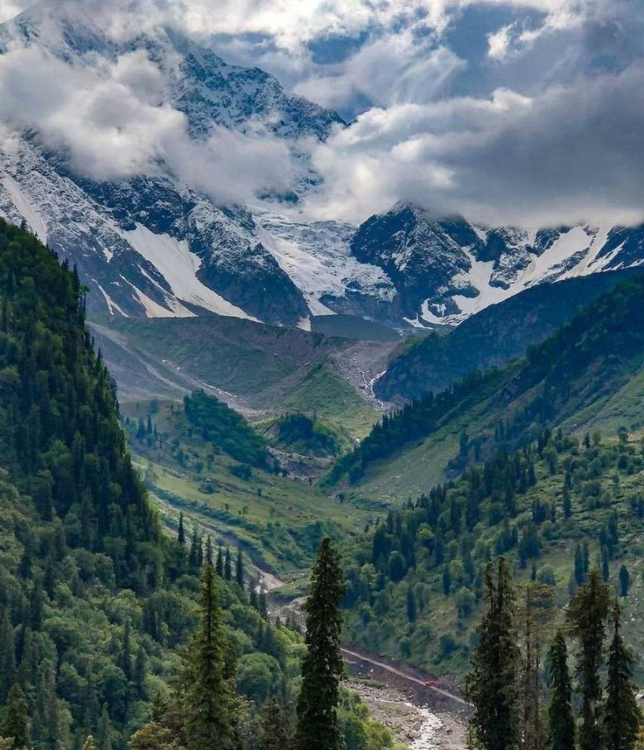
Contact Us
Phone : +91-9958794041
Website : www.traveltoindia.org
Email : traveltoindiaa@gmail.com
Address : TA 55/F, Om vihar, Friday market, New Delhi 110059, Uttam nagar West Metro Station

Slide 12
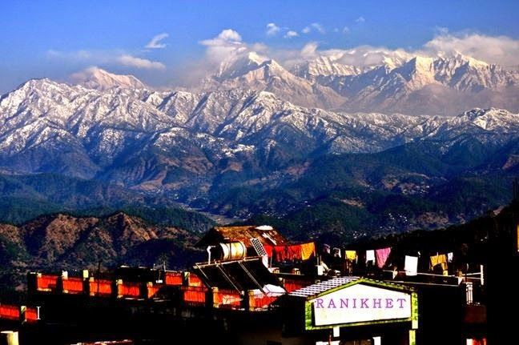
THANK YOU

