Slide 1
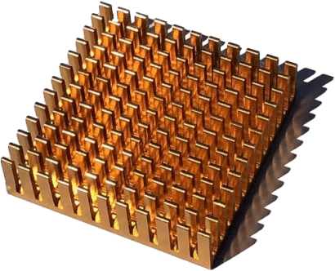
Airwave Defender Electromagnetic field (EMF) protection

Slide 2
Introduction
In an era dominated by technology, our lives are intricately woven with the fabric of electromagnetic fields (EMF). While the convenience of modern devices has revolutionized the way we live, it comes at a cost — the pervasive exposure to EMF radiation. Recognizing the growing concerns surrounding this issue, Airwave Defender emerges as a revolutionary device designed to provide robust protection against harmful electromagnetic fields. In this article, we will delve into what Airwave Defender is, how it works, its benefits, ingredients, and the reasons why it stands out as the preferred choice in the battle against EMF radiation.

Slide 3

What is Airwave Defender?
Airwave Defender is not just another gadget; it is a sophisticated device engineered to shield individuals from the adverse effects of electromagnetic field (EMF) radiation. The product capitalizes on quantum scalar technology, a cutting-edge innovation that generates targeted vibrational frequencies. These frequencies work in tandem to neutralize the detrimental impacts of EMF radiation, offering a proactive defense mechanism for the body.

Slide 4
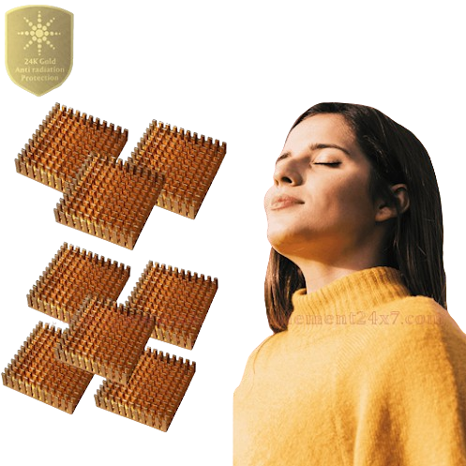
How Does Airwave Defender Work?
At the heart of Airwave Defender Portable EMF protection efficacy lies quantum scalar technology, a revolutionary approach to countering the harmful effects of EMF radiation. Quantum scalar technology operates on the principle that every object has a unique vibrational frequency. When exposed to EMF radiation, the body's natural balance can be disrupted. Airwave Defender steps in by emitting specific scalar frequencies that align with the body's natural resonance, creating a shield against the disruptive effects of EMF radiation.

Slide 5
Benefits of Airwave Defender:
Comprehensive EMF Protection: Airwave Defender EMF protector offers a holistic solution, providing protection against a wide spectrum of electromagnetic frequencies emitted by various devices, including smartphones, laptops, Wi-Fi routers, and other electronic gadgets.
Non-Invasive and Portable:Unlike some other EMF protection methods, Airwave Defender is non-intrusive and portable. The compact design allows users to carry the device with them wherever they go, ensuring continuous protection in various environments.
User-Friendly: Airwave Defender is designed with user convenience in mind. Its simple operation requires no technical expertise, making it accessible to individuals of all ages. Users can effortlessly integrate it into their daily routines without any disruption.

Slide 6

Risk-Free Purchase with Our 30-Day Money Back Guarantee
Airwave Defender is dedicated to providing products of the highest quality and effectiveness. They back their merchandise with a 30-day money-back guarantee for all purchases, ensuring that if you are not satisfied, you can return the product for a full refund. You can select the ideal EMF protection for your lifestyle with confidence, knowing that there is no risk involved. Don't hesitate, place your order today and experience the peace of mind that comes with it.
Click here to visit

