Slide 1



INNOVA CRYSTA-
THE ULTIMATE ROAD TRIP COMPANION

Slide 2

COMFORT REDEFINED
Experience luxury with ergonomic and supportive seats. Enjoy ample room for passengers, ensuring a comfortable ride.

Slide 3
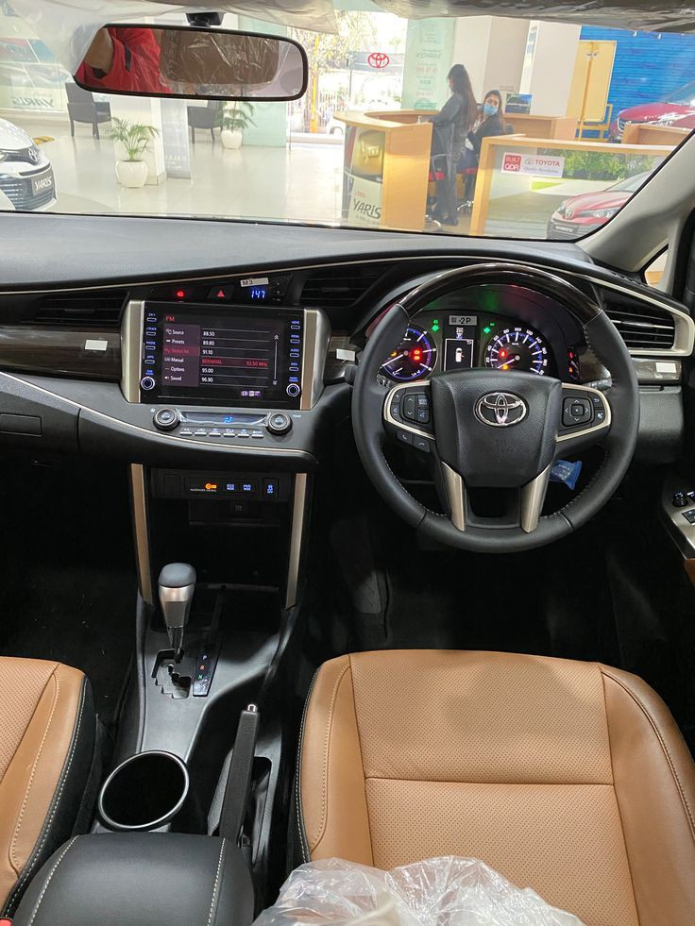


SMOOTH TRAVEL EXPERIENCE
Advanced suspension for a seamless journey on various terrains. Ergonomically designed for driver convenience.

Slide 4

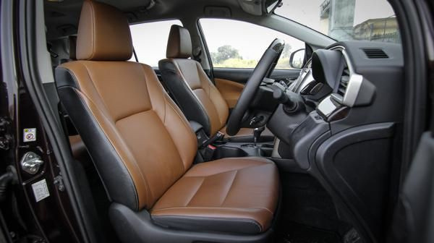
GENEROUS CARGO SPACE
Ample Luggage Room with trunk for all your travel essentials. Foldable seats for extra cargo space as needed.

Slide 5
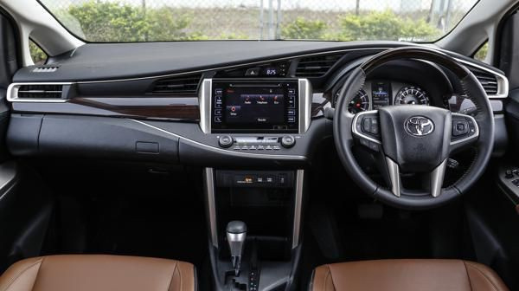
SAFETY FEATURES
Advanced safety features like ABS, airbags, and more. Reliable braking system, ensuring safety during sudden stops.

Slide 6

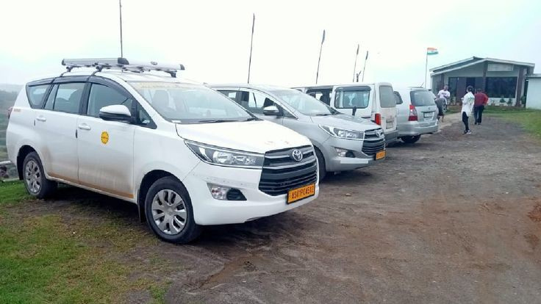
ENTERTAINMENT ON-THE-GO
Infotainment system to keep everyone entertained with advanced audio and connectivity.
Connectivity options with Seamless integration with smartphones and devices.

Slide 7

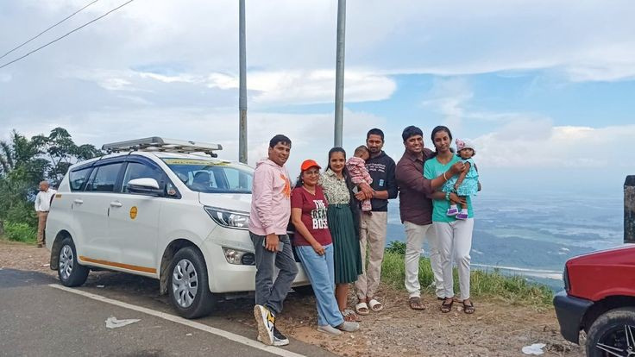
VERSATILITY UNLEASHED
Adaptable for any trip, ideal for family vacations, business travel, or weekend getaways. Provide efficient Fuel Economy, make the most of your journey without frequent refueling.

Slide 8

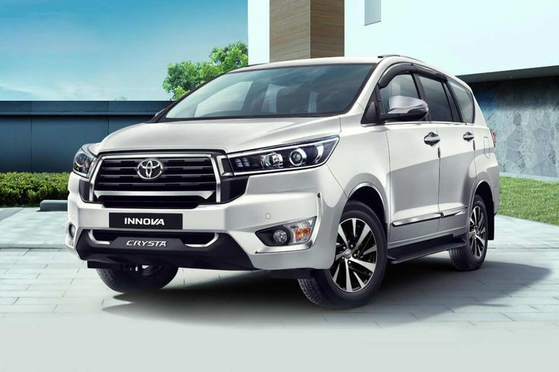
INNOVA CRYSTA FOR YOUR NEXT TRIP
We offer Innova Crysta on rent at best price for an ensured comfortable road trip throughout. The car rental services by India Tour Taxi gives the flexibility to ride anywhere, anytime and hire a car on rent from various models as Innova, Maruti, Indica. Booking Innova on rent in Delhi provides convenience and mobility at an affordable price.

Slide 9
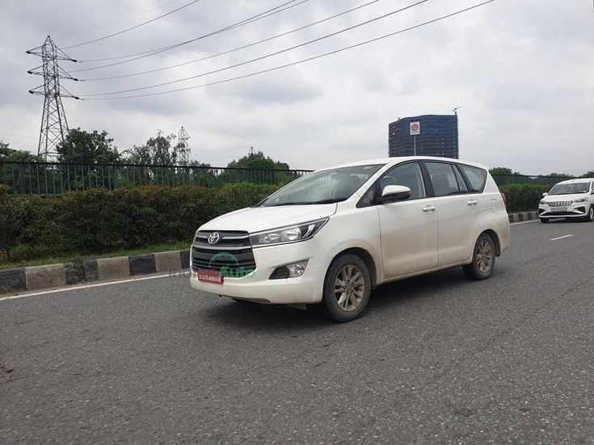
Thank you!
Connect with us.
PHONE:
+91 9599578493
WEBSITE:
www.indiatourtaxi.com
EMAIL:
Info@indiatourtaxi.com
ADDRESS:
Plot No -6, Heart & Lung Hospital Aram Bagh, Pahar Ganj, New Delhi - 110055

