Slide 1

Unveiling the Science Behind Puravive Weight Loss Supplement

Slide 2
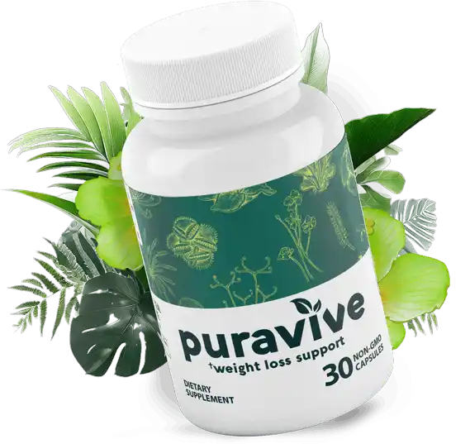
Introduction:
Puravive Weight Loss is a dietary supplement designed to support individuals in their weight management efforts. Comprising a unique blend of natural ingredients, this supplement aims to enhance metabolism, curb cravings, and promote overall well-being. Let's explore the key components that make Puravive stand out in the crowded market of weight loss supplements.

Slide 3
Understanding Puravive
Puravive is marketed as an all-natural weight loss supplement designed to support healthy and sustainable weight management. The product's formulation aims to harness the power of natural ingredients to enhance metabolism, control appetite, and promote fat burning.

Slide 4


The Science Behind Puravive
Metabolism Boost:
Green tea extract, a common ingredient in many weight loss supplements, contains catechins that may help increase metabolism. Research suggests that the combination of caffeine and catechins can contribute to fat oxidation and improved metabolic rates.
Natural Ingredients:
Puravive boasts a blend of natural ingredients, including botanical extracts and herbs. Some of the key components include green tea extract, Garcinia Cambogia, and black pepper extract.
Appetite Control:
Garcinia Cambogia is often touted for its potential to suppress appetite. The active compound, hydroxycitric acid (HCA), is believed to influence serotonin levels, which could contribute to reduced cravings and emotional eating.
Fat Burning:
Black pepper extract, specifically its active compound piperine, is included in Puravive for its potential to enhance the absorption of other ingredients. This may maximize the effectiveness of the formula in targeting and burning stored fat.

Slide 5


Key Ingredients: The Power Behind Puravive
Garcinia Cambogia: Central to Puravive's formula is Garcinia Cambogia, a tropical fruit known for its active ingredient, hydroxycitric acid (HCA). HCA is believed to inhibit an enzyme that plays a role in fat storage, potentially aiding in weight loss.
Green Tea Extract: Renowned for its antioxidant properties, green tea extract is a common inclusion in weight loss supplements. It is thought to boost metabolism and support fat burning.
Cayenne Pepper: Adding a spicy kick to the mix, cayenne pepper is said to have thermogenic properties, potentially increasing calorie burning and reducing appetite.
BHB Ketones: Often associated with ketogenic diets, beta-hydroxybutyrate (BHB) ketones may help the body enter a state of ketosis, where it burns fat for energy.

Slide 6

Potential Benefits of Puravive
Mood Enhancement:
Some ingredients in Puravive, such as Garcinia Cambogia, are associated with potential mood-boosting effects due to their impact on serotonin levels.
Natural Approach:
For those seeking a natural alternative to synthetic weight loss supplements, Puravive's reliance on botanical extracts may be appealing.
Weight Loss:
The combination of metabolism-boosting ingredients and appetite control may contribute to effective weight loss for some individuals.
Energy Boost:
As the supplement aims to utilize stored fat for energy, users may experience an increase in energy levels throughout the day.

Slide 7


Conclusion
Puravive presents itself as a natural and holistic approach to weight loss, incorporating well-known ingredients with potential benefits. However, it's crucial to approach such supplements with a realistic perspective. While the science behind some ingredients is promising, the overall efficacy of the specific Puravive formulation may require further research.
Before embarking on any weight loss journey with supplements, individuals should consult with a healthcare professional. Sustainable weight loss involves a combination of a balanced diet, regular exercise, and a healthy lifestyle. While Puravive may offer support, it should not replace these fundamental principles in achieving and maintaining a healthy weight.
In the dynamic landscape of weight loss supplements, Puravive stands as one option among many. As with any decision related to health and wellness, thorough research and informed choices are paramount for achieving long-term success.

