Slide 1


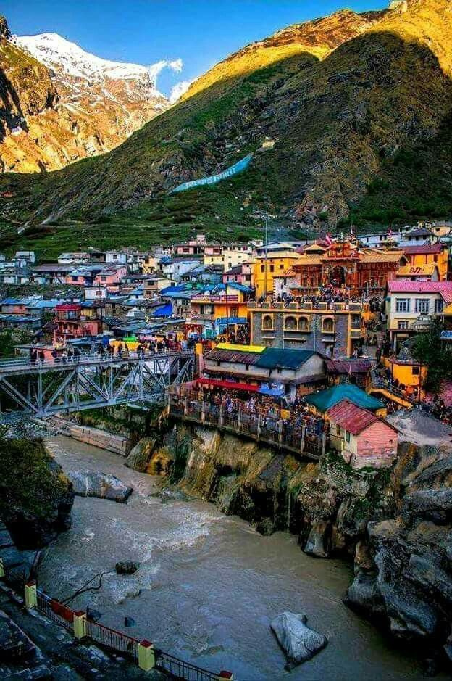


BOOK CAR RENTAL SERVICES FOR DELHI HARIDWAR , RISHIKESH TRIP

Slide 2



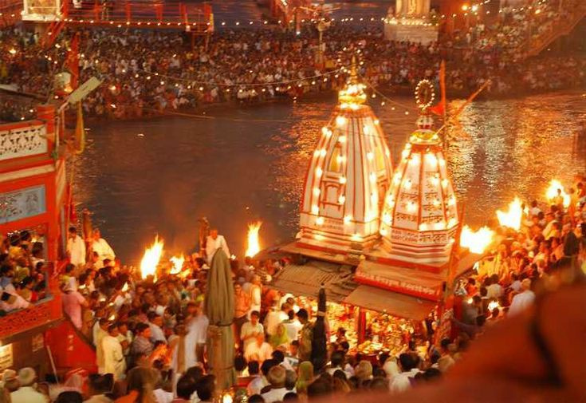


Overview
Holy cities of Haridwar and Rishikesh are located in the Garhwal region of Uttarakhand. Haridwar literally means ‘the abode of Lord Vishnu’ and millions of people flock here every year to take part in an annual pilgrimage. Rishikesh is another perfect weekend getaway endowed with natural beauty. Haridwar and Rishikesh are considered the “twin national heritage cities”. Since both the cities are popular tourist destinations, they provide a wide range of gastronomic options that are delicious and caters to people on various budget.

Slide 3
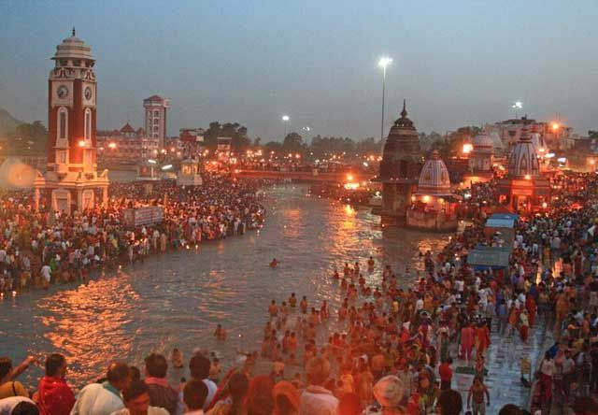
Har ki Pauri Ghat, Haridwar
02
The ghat is a sensory spectacle when the Ganga aarti is performed. With bells ringing and flaming torches being moved in a harmonious synchronisation by the Pandits, evening at the ghat is the experience of a lifetime. Push yourself out of bed in the early hours of the day and head to the ghat to witness surreal beauty of the sun rising from the river.
03
04
05
06
07

Slide 4

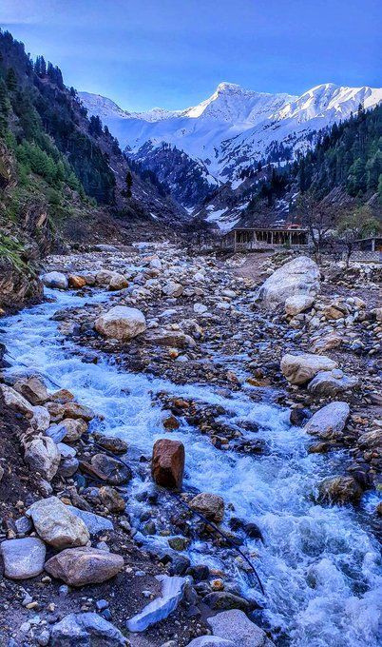




Things to do in Haridwar
-Visit the Temple of Mansa Devi.
-If you’re looking for a peaceful abode for meditation, the city is home to a number of ashrams radiating vibrant positivity and a refreshing atmosphere.
- Haridwar also offers enthralling activities such as trekking, bird-watching and raftingVisit Rajaji National Park,

Slide 5


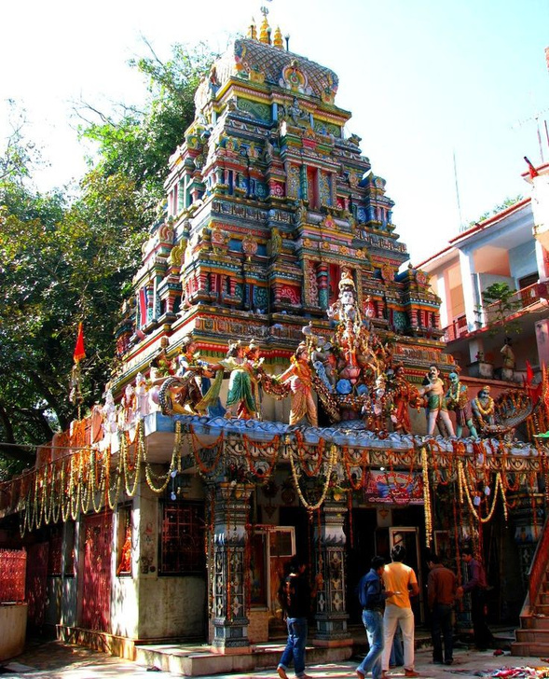
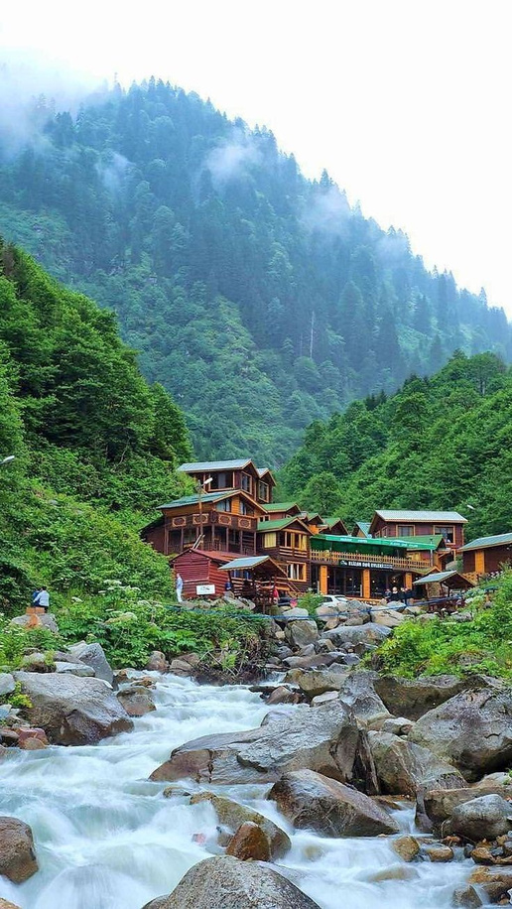
Rishikesh
Rishikesh is very popular with adrenaline junkies who are lured by the white rapids of the Ganga. White water rafting is very popular and you can choose the grade (ranging from 1 to 4) based on your age and appetite for adventure. Bungee jumping is another activity you can indulge in here for some extra thrills.

Slide 6
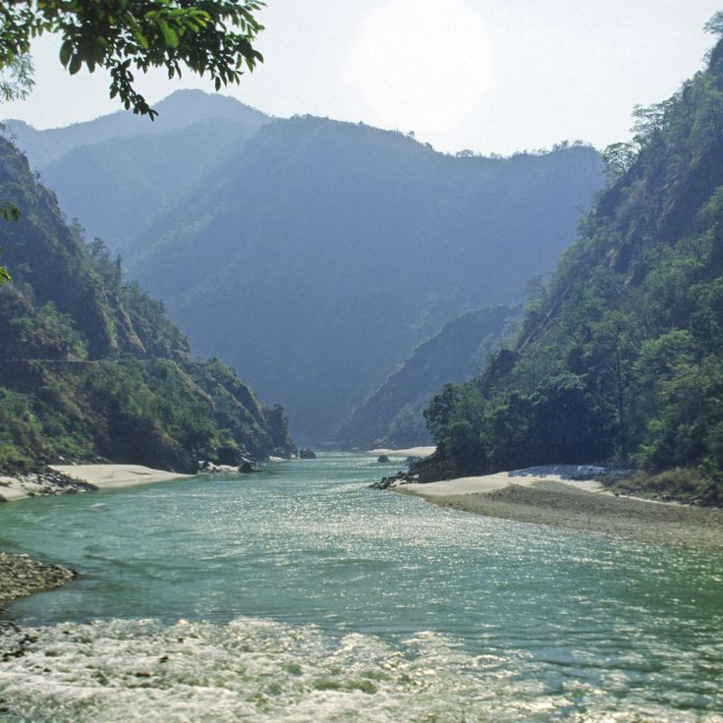

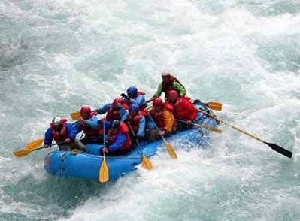
Things to do in Rishikesh
Rishikesh has been a haven for those seeking spiritual enlightenment through yoga and meditation.
Rishikesh is adorned with several ancient temples around Lakshman Jhoola, the bridge that spans the Ganga. The Neelkanth Mahadev Temple and the Trimbakeshwar Temple are most popular one here
Triveni Ghat is the biggest and the most famous ghat of Rishikesh.
River rafting and Bungee jumping is another activity you can indulge in here for some extra thrills.

Slide 7

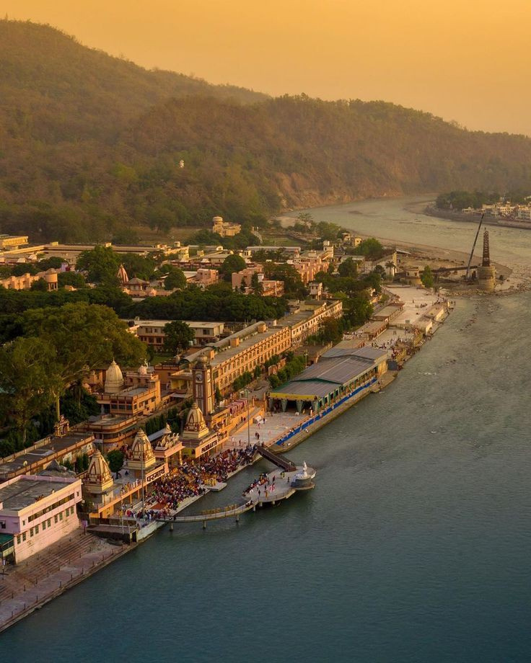
Advantages of Car Rental Service for Haridwar, Rishikesh Trip
With a car rental, you have the flexibility to explore Haridwar and Rishikesh at your own pace, creating a customized itinerary tailored to your preference.
Enjoy a comfortable journey in well-maintained vehicles, providing a relaxing and enjoyable travel experience amidst the scenic route from Delhi to Haridwar and Rishikesh.
The convenience of doorstep pickup in Delhi eliminates the need for public transportation, ensuring a hassle-free start to your journey
Depending on the size of your group, a car rental can be a cost-effective option compared to other modes of transportation, especially when considering the convenience it offers.
Sales

Slide 8

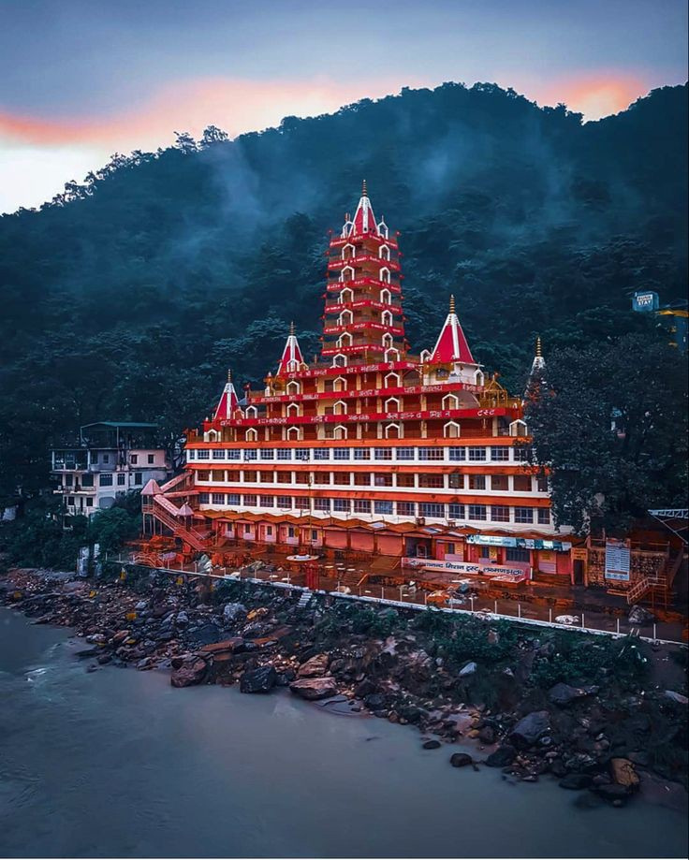
Haridwar Rishikesh Trip From Delhi
The cost of a car rental service for a Haridwar-Rishikesh trip from Delhi varies based on factors such as the type of vehicle, duration of rental, and any additional services included. Hire Innova Crysta Car on rent in Delhi starting at 17 Rs per km for a comfortable road trip. Indiatourtaxi.com is one of the best oustation car rental in delhi. We provide best and reliable service.

Slide 9
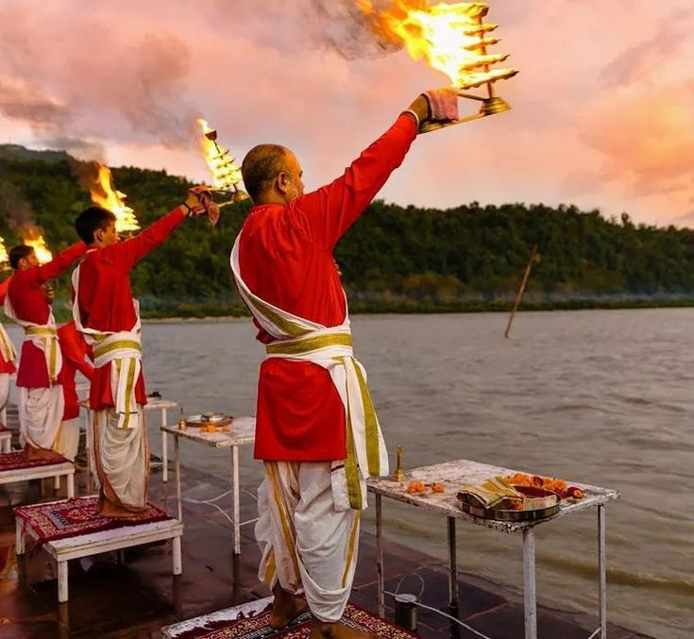




THANK YOU
+91-9599578439
info@indiatourtaxi.com
www.indiatourtaxi.com
Plot No -6, Heart & Lung Hospital Aram Bagh, Pahar Ganj, New Delhi - 110055

